Slide 1
Econ 645: Week 2
Instrumental Variables

Slide 2
Overview
Instrumental Variables
Motivation: Dealing with Endogeneity
Multivariate Regression Models
Two-Stage Least Squares (2SLS or TSLS)
For Classic Errors-in-Variables (CEV) Problem
Testing for Endogeneity and Overidentifying Restrictions
Stata Lab
Instrumental Variables
Reading and importing data into Stata
Saving and exporting data out of Stata
Data Cleaning
Log Files

Slide 3
Motivation: Endogeneity

Slide 4
Motivation
Endogeneity is a problem across different econometric analysis
Omitted Variables
Measurement error or classic error-in-variables
Simultaneity bias
Instrumental Variable (IV) is a possible identification strategy
Key: An identification strategy is a research design to deal with observed and unobserved confounding variables in observational data
IV is a potential identification strategy to deal with endogeneity
IV does have drawback
Lots of assumptions
Larger standard errors than OLS estimator

Slide 5
Motivation
Endogeneity will confound and bias our OLS estimator
We can ignore it and have biased and inconsistent OLS estimators
We can try a proxy variable for omitted variables,
This has problems if our proxy variables are correlated with other explanatory variables
We can use fixed effects if we have panel data and our omitted variables are time-invariant (don’t change),
This does not resolve time-varying omitted variables
Instrumental Variables (IV) can resolve some cases of endogeneity
If we have a good instrument
If our IV assumptions hold

Slide 6
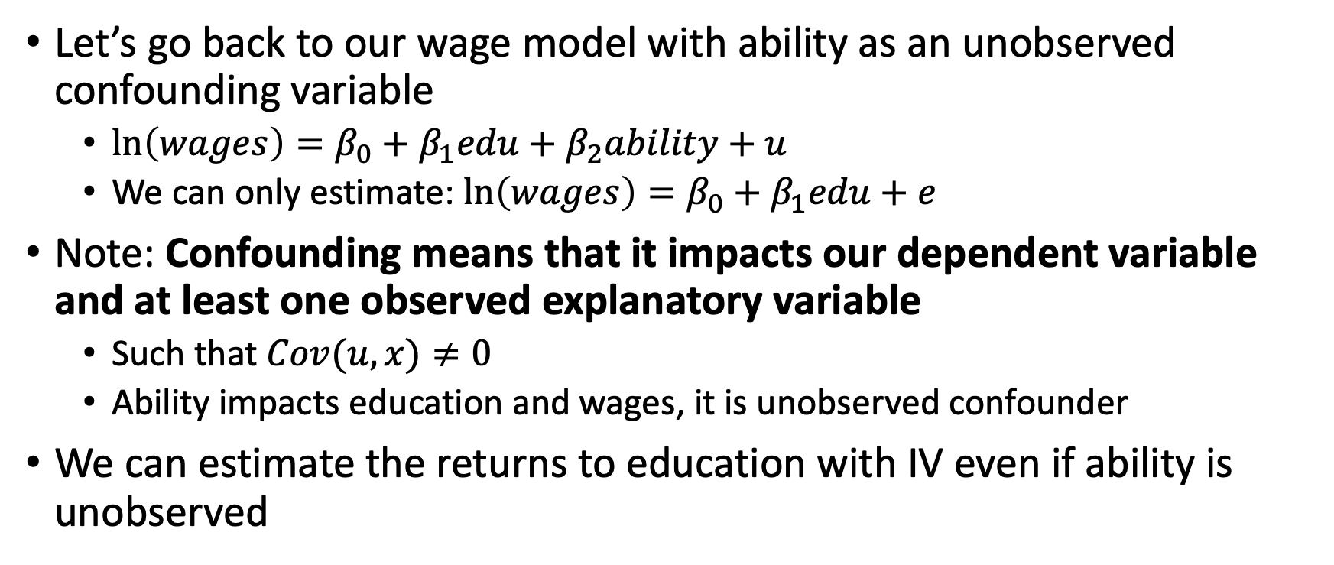
Motivation
Let’s go back to our wage model with ability as an unobserved confounding variable
$\ln\left(wages\right)=β_{0}+β_{1}edu+β_{2}ability+u$
We can only estimate: $\ln\left(wages\right)=β_{0}+β_{1}edu+e$
Note: Confounding means that it impacts our dependent variable and at least one observed explanatory variable
Such that $Cov(u,x)≠0$
Ability impacts education and wages, it is unobserved confounder
We can estimate the returns to education with IV even if ability is unobserved

Slide 7
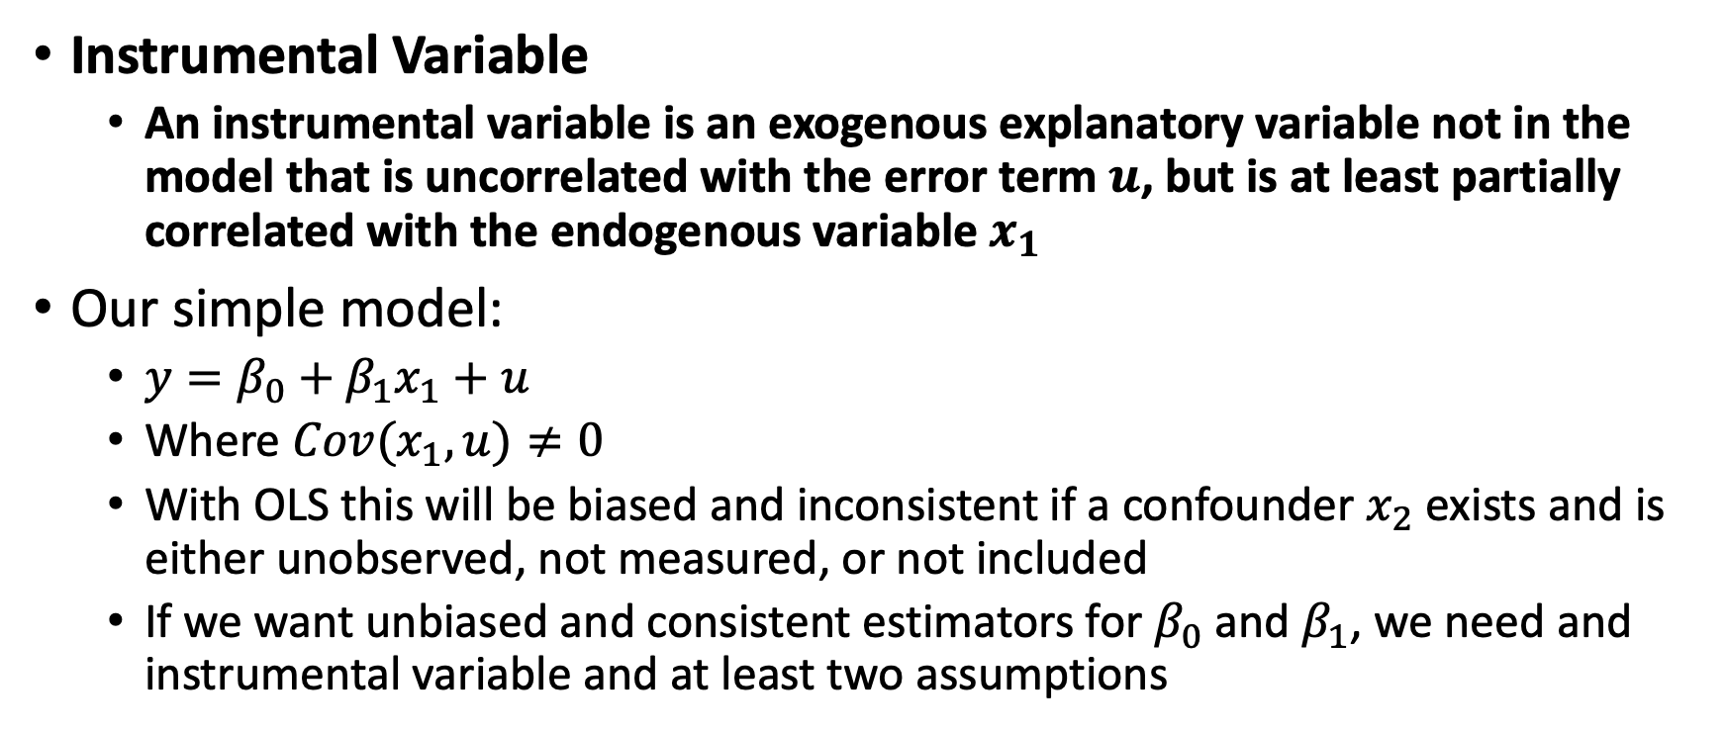
Instrumental Variables
Instrumental Variable
An instrumental variable is an exogenous explanatory variable not in the model that is uncorrelated with the error term $u$, but is at least partially correlated with the endogenous variable $x_{1}$
Our simple model:
$y=β_{0}+β_{1}x_{1}+u$
Where $Cov(x_{1},u)≠0$
With OLS this will be biased and inconsistent if a confounder $x_{2}$ exists and is either unobserved, not measured, or not included
If we want unbiased and consistent estimators for $β_{0}$ and $β_{1}$, we need and instrumental variable and at least two assumptions

Slide 8
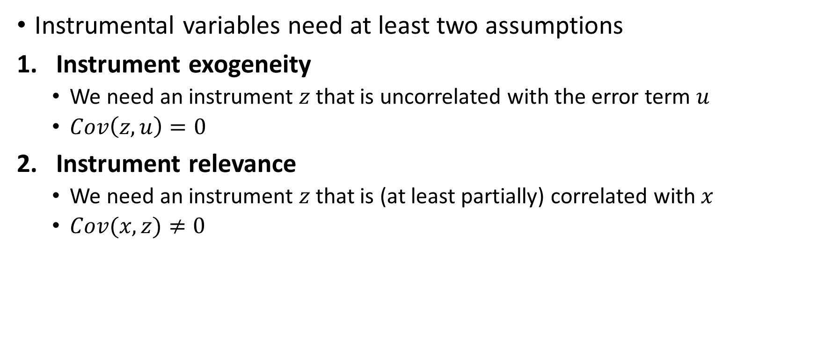
Instrumental Variables
Instrumental variables need at least two assumptions
Instrument exogeneity
We need an instrument $z$ that is uncorrelated with the error term $u$
$Cov\left(z,u\right)=0$
Instrument relevance
We need an instrument $z$ that is (at least partially) correlated with $x$
$Cov(x,z)≠0$

Slide 9
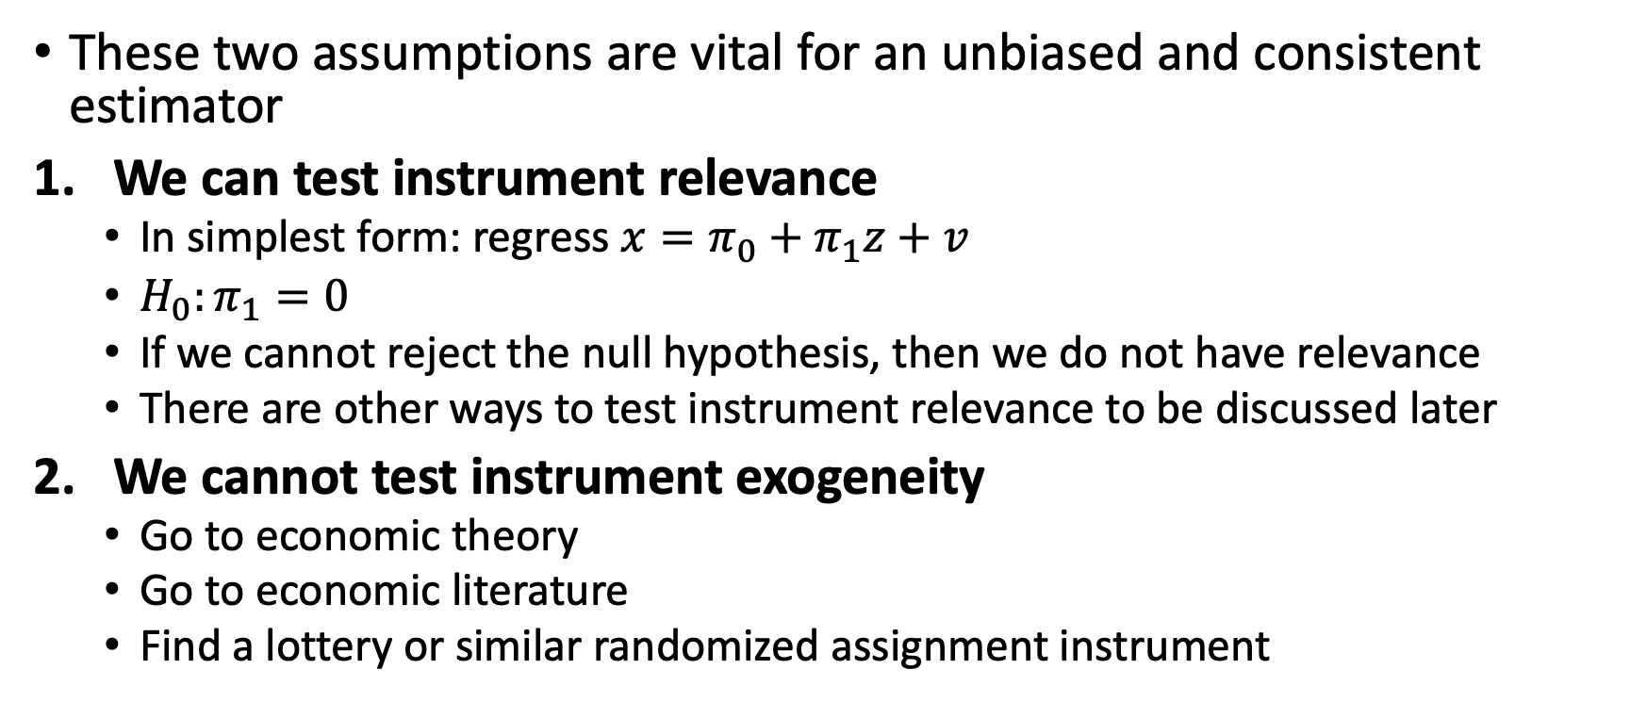
Instrumental Variables
These two assumptions are vital for an unbiased and consistent estimator
We can test instrument relevance
In simplest form: regress $x=π_{0}+π_{1}z+v$
$H_{0}:π_{1}=0$
If we cannot reject the null hypothesis, then we do not have relevance
There are other ways to test instrument relevance to be discussed later
We cannot test instrument exogeneity
Go to economic theory
Go to economic literature
Find a lottery or similar randomized assignment instrument

Slide 10
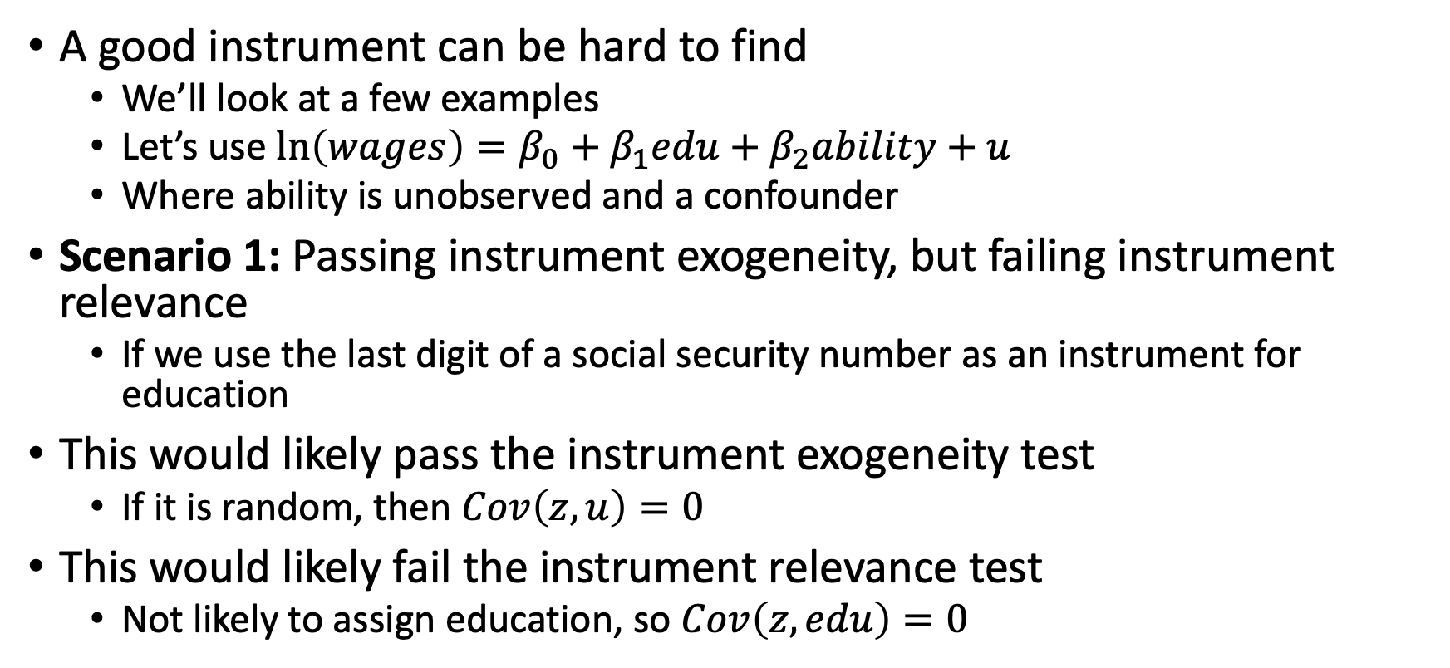
Instrumental Variables
A good instrument can be hard to find
We’ll look at a few examples
Let’s use $\ln\left(wages\right)=β_{0}+β_{1}edu+β_{2}ability+u$
Where ability is unobserved and a confounder
Scenario 1: Passing instrument exogeneity, but failing instrument relevance
If we use the last digit of a social security number as an instrument for education
This would likely pass the instrument exogeneity test
If it is random, then $Cov\left(z,u\right)=0$
This would likely fail the instrument relevance test
Not likely to assign education, so $Cov\left(z,edu\right)=0$

Slide 11
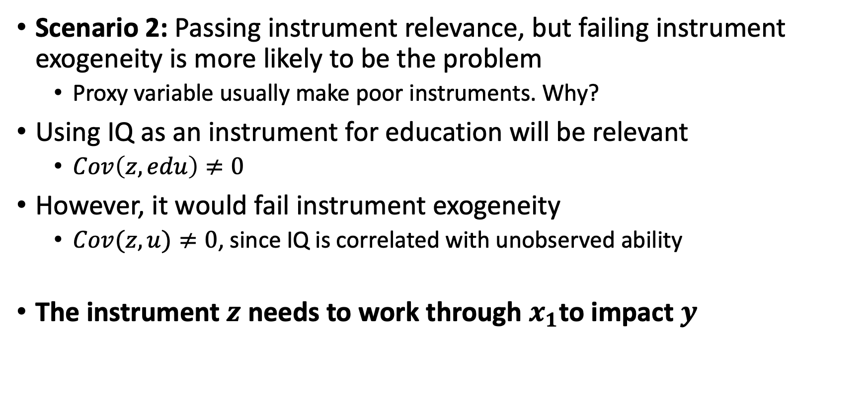
Instrumental Variables
Scenario 2: Passing instrument relevance, but failing instrument exogeneity is more likely to be the problem
Proxy variable usually make poor instruments. Why?
Using IQ as an instrument for education will be relevant
$Cov\left(z,edu\right)≠0$
However, it would fail instrument exogeneity
$Cov(z,u)≠0$, since IQ is correlated with unobserved ability
The instrument $z$ needs to work through $x_{1}$to impact $y$

Slide 12
Instrumental Variables
You have to be creative sometimes with instruments
Parent’s education is possible
This will likely be correlated with other unobserved factors
Wooldridge mention’s number of siblings but…
What about sex combinations of siblings?
Families that have more kids instead of stopping at two with one boy and one girl?
Investing more into education if randomly have one boy and one girl
What about the distance to a four year college?
What about distance to September school cutoff for school attendance?
What about lottery numbers?

Slide 13
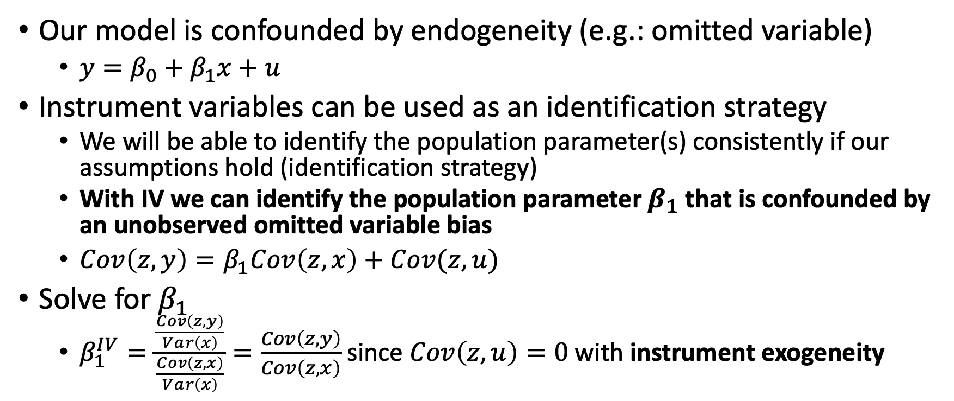
Identification with Instrumental Variables
Our model is confounded by endogeneity (e.g.: omitted variable)
$y=β_{0}+β_{1}x+u$
Instrument variables can be used as an identification strategy
We will be able to identify the population parameter(s) consistently if our assumptions hold (identification strategy)
With IV we can identify the population parameter $β_{1}$ that is confounded by an unobserved omitted variable bias
$Cov\left(z,y\right)=β_{1}Cov\left(z,x\right)+Cov(z,u)$
Solve for $β_{1}$
$β_{1}^{IV}=\frac{\frac{Cov\left(z,y\right)}{Var\left(x\right)}}{\frac{Cov\left(z,x\right)}{Var\left(x\right)}}=\frac{Cov\left(z,y\right)}{Cov\left(z,x\right)}$ since $Cov\left(z,u\right)=0$ with instrument exogeneity

Slide 14
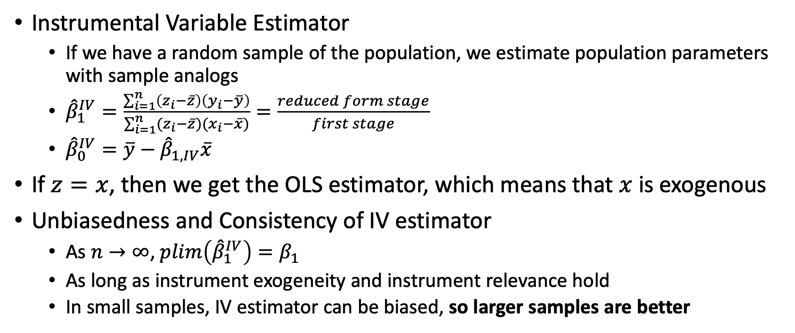
Instrumental Variable Estimator
Instrumental Variable Estimator
If we have a random sample of the population, we estimate population parameters with sample analogs
${\hat{β}}_{1}^{IV}=\frac{\sum_{i=1}^{n}{\left(z_{i}−\overline{z}\right)\left(y_{i}−\overline{y}\right)}}{\sum_{i=1}^{n}{(z_{i}−\overline{z})(x_{i}−\overline{x})}}=\frac{reduced form stage}{first stage}$
${\hat{β}}_{0}^{IV}=\overline{y}−{\hat{β}}_{1,IV}\overline{x}$
If $z=x$, then we get the OLS estimator, which means that $x$ is exogenous
Unbiasedness and Consistency of IV estimator
As $n→∞$, $plim\left({\hat{β}}_{1}^{IV}\right)=β_{1}$
As long as instrument exogeneity and instrument relevance hold
In small samples, IV estimator can be biased, so larger samples are better

Slide 15
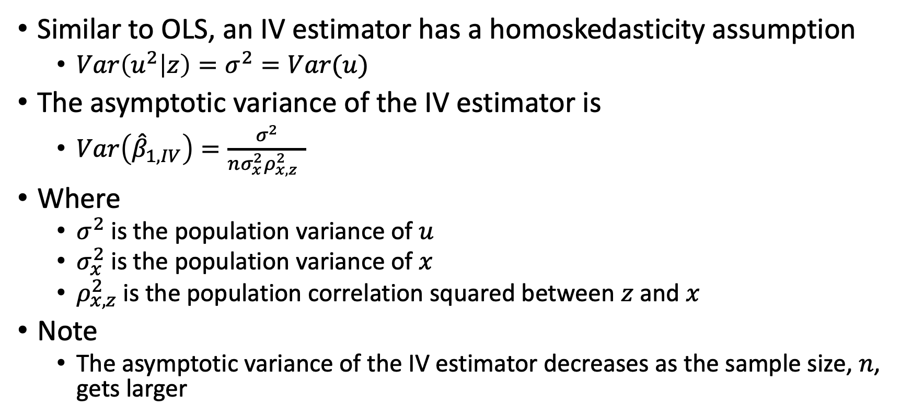
Statistical Inference with IV Estimator
Similar to OLS, an IV estimator has a homoskedasticity assumption
$Var\left(u^{2} | z\right)=σ^{2}=Var(u)$
The asymptotic variance of the IV estimator is
$Var\left({\hat{β}}_{1,IV}\right)=\frac{σ^{2}}{nσ_{x}^{2}ρ_{x,z}^{2} }$
Where
$σ^{2}$ is the population variance of $u$
$σ_{x}^{2}$ is the population variance of $x$
$ρ_{x,z}^{2}$ is the population correlation squared between $z$ and $x$
Note
The asymptotic variance of the IV estimator decreases as the sample size, $n$, gets larger

Slide 16
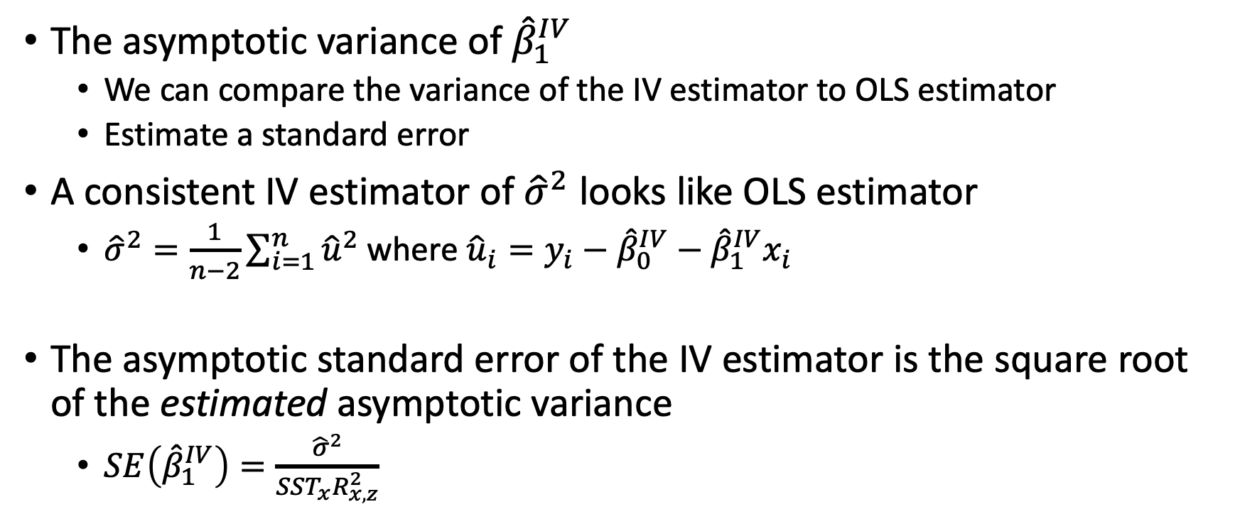
Statistical Inference with IV Estimator
The asymptotic variance of ${\hat{β}}_{1}^{IV}$
We can compare the variance of the IV estimator to OLS estimator
Estimate a standard error
A consistent IV estimator of ${\hat{σ}}^{2}$ looks like OLS estimator
${\hat{σ}}^{2}=\frac{1}{n−2}\sum_{i=1}^{n}{{\hat{u}}^{2}}$ where ${\hat{u}}_{i}=y_{i}−{\hat{β}}_{0}^{IV}−{\hat{β}}_{1}^{IV}x_{i}$
The asymptotic standard error of the IV estimator is the square root of the estimated asymptotic variance
$SE\left({\hat{β}}_{1}^{IV}\right)=\frac{{\hat{σ}}^{2}}{SST_{x}R_{x,z}^{2}}$

Slide 17
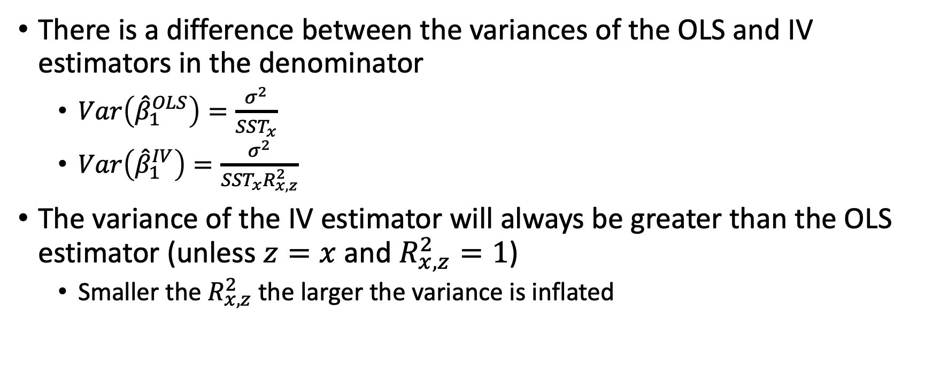
Statistical Inference with IV Estimator
There is a difference between the variances of the OLS and IV estimators in the denominator
$Var\left({\hat{β}}_{1}^{OLS}\right)=\frac{σ^{2}}{SST_{x}}$
$Var\left({\hat{β}}_{1}^{IV}\right)=\frac{σ^{2}}{SST_{x}R_{x,z}^{2}}$
The variance of the IV estimator will always be greater than the OLS estimator (unless $z=x$ and $R_{x,z}^{2}=1$)
Smaller the $R_{x,z}^{2}$ the larger the variance is inflated

Slide 18
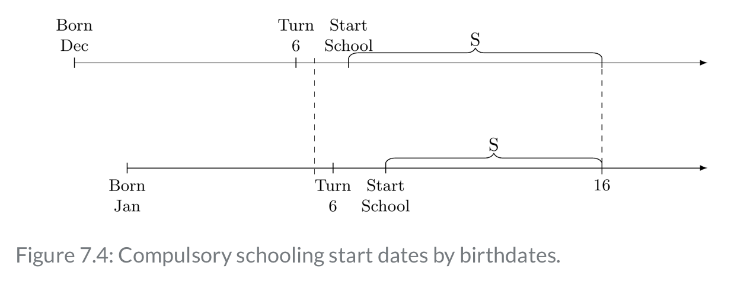
Binary Variables as IVs Example
We can use binary variables as IV, as well. Angrist and Kruger (1991) want to estimate the returns to education
Education is confounded by ability, so they look for an instrument for additional years of education
Their IV was simple
Were you born after or before the cutoff for the school year
Those before the cutoff got more schooling

Slide 19
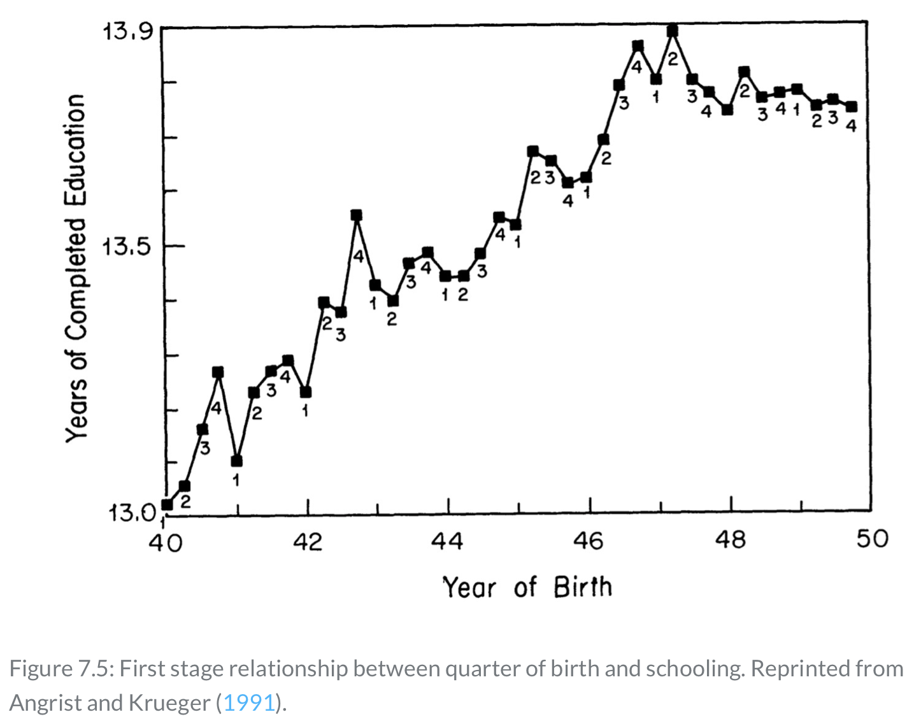
Instrumental Variable Example
Angrist and Krueger (1991) use birth quarter as an instrument for education in the first-stage
People right before the cutoff for education (December) would get more education than after the January cutoff

Slide 20
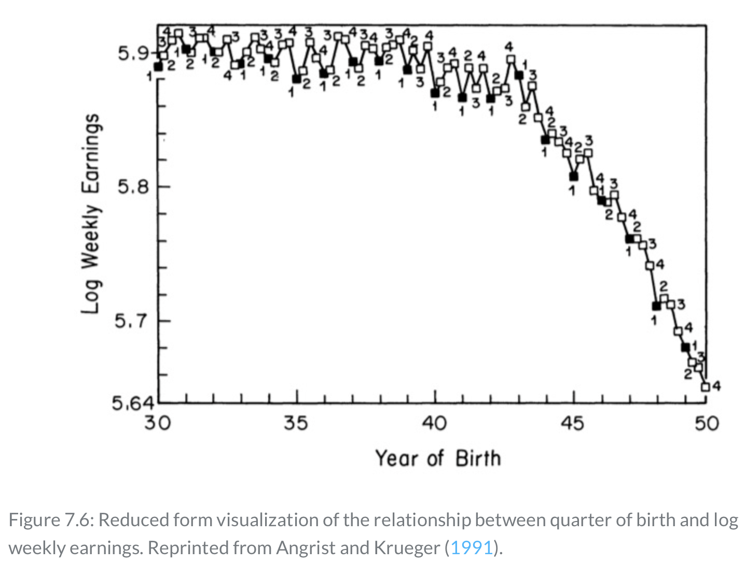
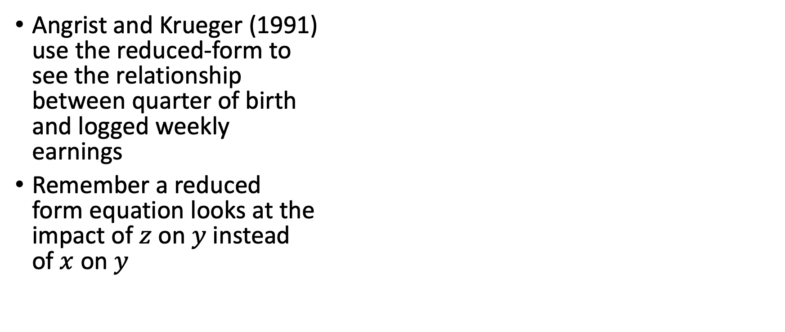
Instrumental Variable Example
Angrist and Krueger (1991) use the reduced-form to see the relationship between quarter of birth and logged weekly earnings
Remember a reduced form equation looks at the impact of $z$ on $y$ instead of $x$ on $y$

Slide 21
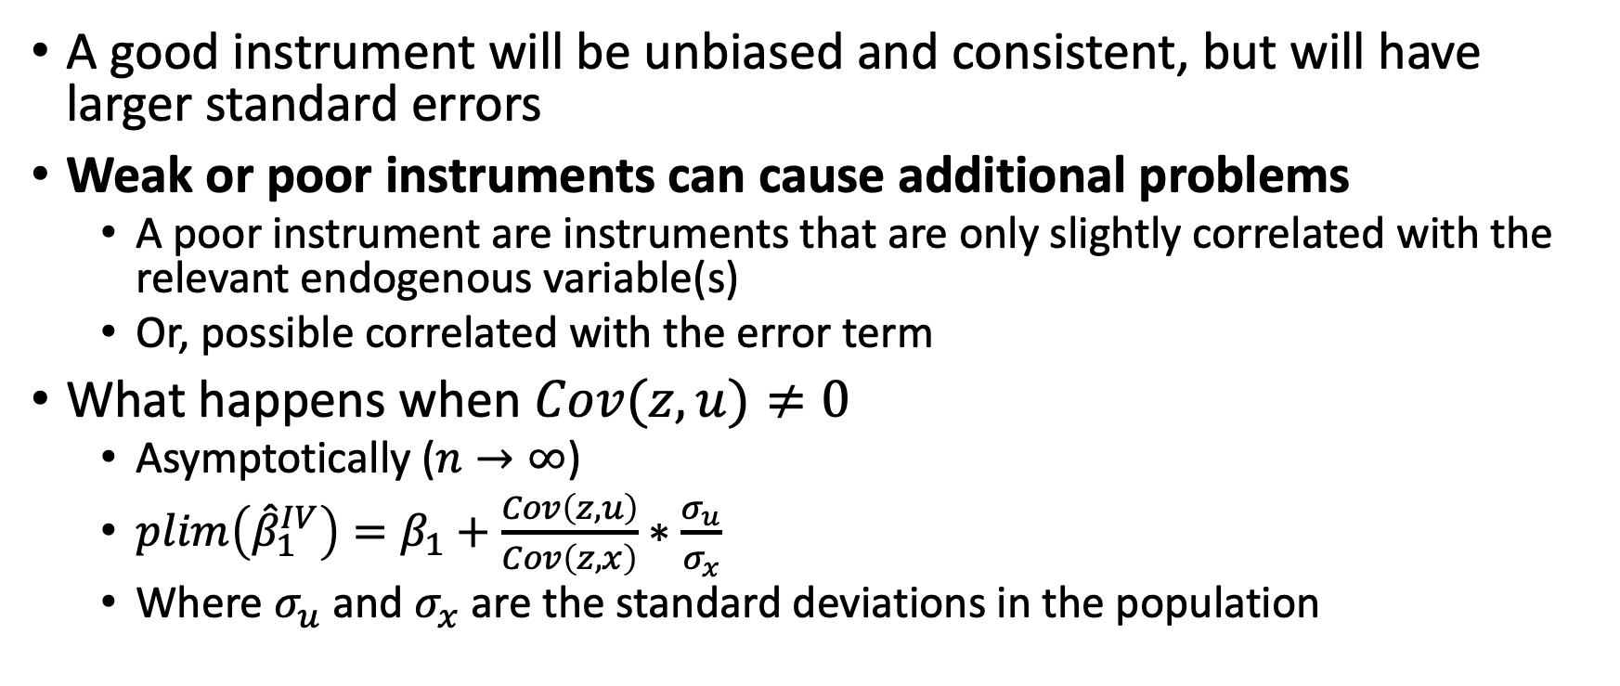
Properties of IV with a Poor Instrument
A good instrument will be unbiased and consistent, but will have larger standard errors
Weak or poor instruments can cause additional problems
A poor instrument are instruments that are only slightly correlated with the relevant endogenous variable(s)
Or, possible correlated with the error term
What happens when $Cov(z,u)≠0$
Asymptotically ($n→∞$)
$plim\left({\hat{β}}_{1}^{IV}\right)=β_{1}+\frac{Cov\left(z,u\right)}{Cov\left(z,x\right)}∗\frac{σ_{u}}{σ_{x}}$
Where $σ_{u}$ and $σ_{x}$ are the standard deviations in the population

Slide 22
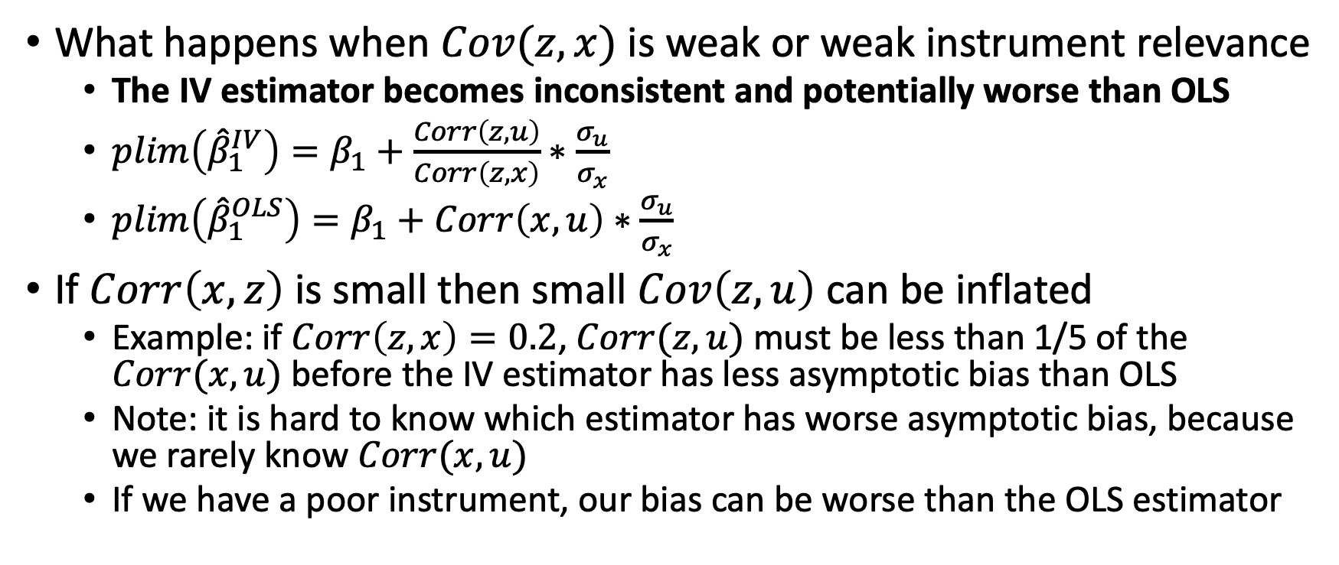
Properties of IV with a Poor Instrument
What happens when $Cov(z,x)$ is weak or weak instrument relevance
The IV estimator becomes inconsistent and potentially worse than OLS
$plim\left({\hat{β}}_{1}^{IV}\right)=β_{1}+\frac{Corr\left(z,u\right)}{Corr\left(z,x\right)}∗\frac{σ_{u}}{σ_{x}}$
$plim\left({\hat{β}}_{1}^{OLS}\right)=β_{1}+Corr\left(x,u\right)∗\frac{σ_{u}}{σ_{x}}$
If $Corr\left(x,z\right)$ is small then small $Cov\left(z,u\right)$ can be inflated
Example: if $Corr\left(z,x\right)=0.2$, $Corr(z,u)$ must be less than 1/5 of the $Corr(x,u)$ before the IV estimator has less asymptotic bias than OLS
Note: it is hard to know which estimator has worse asymptotic bias, because we rarely know $Corr(x,u)$
If we have a poor instrument, our bias can be worse than the OLS estimator

Slide 23
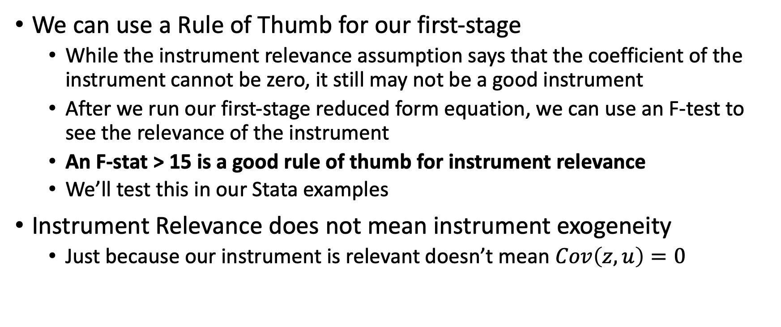
Properties of IV with a Poor Instrument
We can use a Rule of Thumb for our first-stage
While the instrument relevance assumption says that the coefficient of the instrument cannot be zero, it still may not be a good instrument
After we run our first-stage reduced form equation, we can use an F-test to see the relevance of the instrument
An F-stat > 15 is a good rule of thumb for instrument relevance
We’ll test this in our Stata examples
Instrument Relevance does not mean instrument exogeneity
Just because our instrument is relevant doesn’t mean $Cov\left(z,u\right)=0$

Slide 24
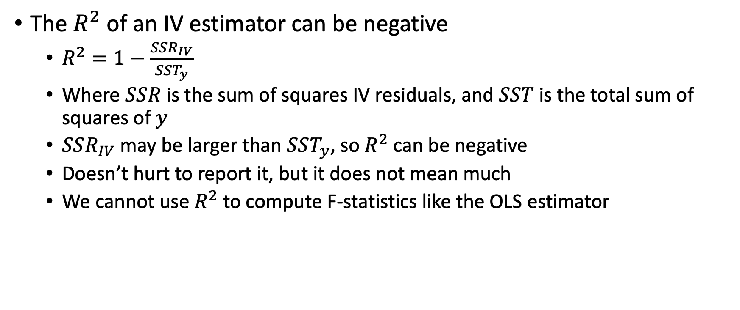
Computing R-Squared after IV Estimation
The $R^{2}$ of an IV estimator can be negative
$R^{2}=1−\frac{SSR_{IV}}{SST_{y}}$
Where $SSR$ is the sum of squares IV residuals, and $SST$ is the total sum of squares of $y$
$SSR_{IV}$ may be larger than $SST_{y}$, so $R^{2}$ can be negative
Doesn’t hurt to report it, but it does not mean much
We cannot use $R^{2}$ to compute F-statistics like the OLS estimator

Slide 25
IV for Multivariate Regressions

Slide 26
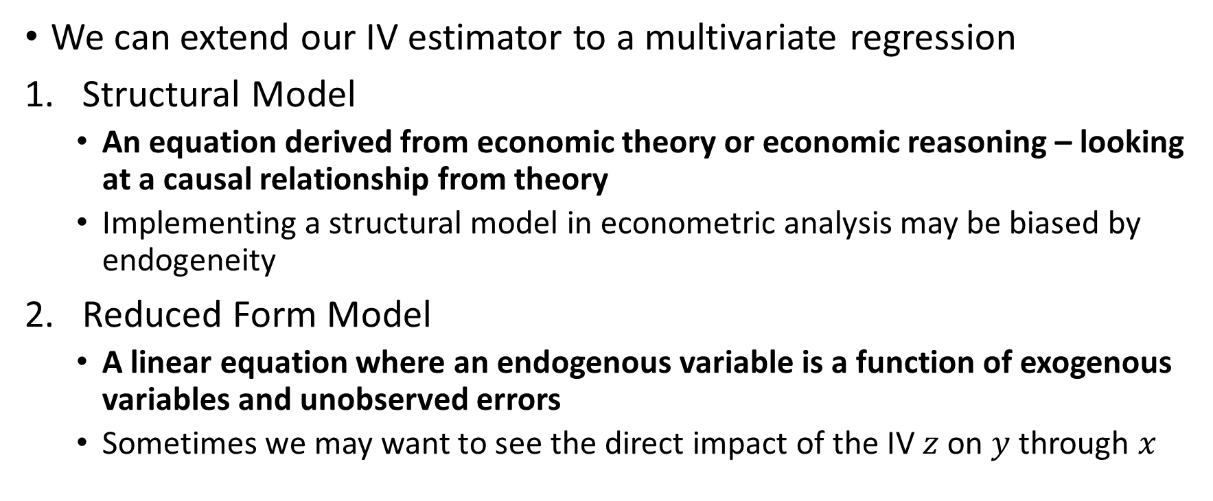
IV Estimation in Multivariate Regression
We can extend our IV estimator to a multivariate regression
Structural Model
An equation derived from economic theory or economic reasoning – looking at a causal relationship from theory
Implementing a structural model in econometric analysis may be biased by endogeneity
Reduced Form Model
A linear equation where an endogenous variable is a function of exogenous variables and unobserved errors
Sometimes we may want to see the direct impact of the IV $z$ on $y$ through $x$

Slide 27
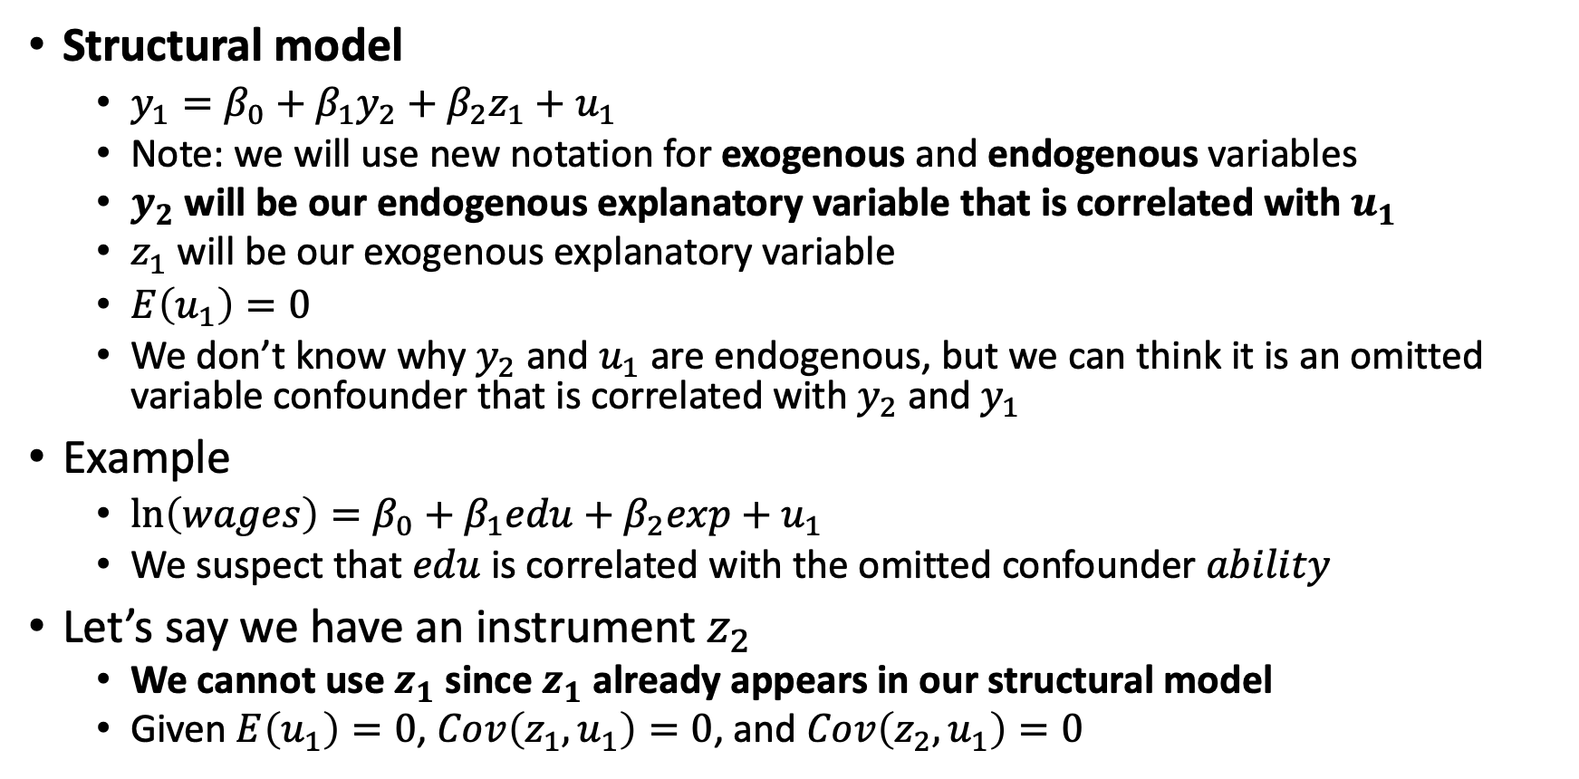
IV Estimation in Multivariate Regression
Structural model
$y_{1}=β_{0}+β_{1}y_{2}+β_{2}z_{1}+u_{1}$
Note: we will use new notation for exogenous and endogenous variables
$y_{2}$ will be our endogenous explanatory variable that is correlated with $u_{1}$
$z_{1}$ will be our exogenous explanatory variable
$E\left(u_{1}\right)=0$
We don’t know why $y_{2}$ and $u_{1}$ are endogenous, but we can think it is an omitted variable confounder that is correlated with $y_{2}$ and $y_{1}$
Example
$\ln\left(wages\right)=β_{0}+β_{1}edu+β_{2}exp+u_{1}$
We suspect that $edu$ is correlated with the omitted confounder $ability$
Let’s say we have an instrument $z_{2}$
We cannot use $z_{1}$ since $z_{1}$ already appears in our structural model
Given $E\left(u_{1}\right)=0$, $Cov\left(z_{1},u_{1}\right)=0$, and $Cov\left(z_{2},u_{1}\right)=0$

Slide 28
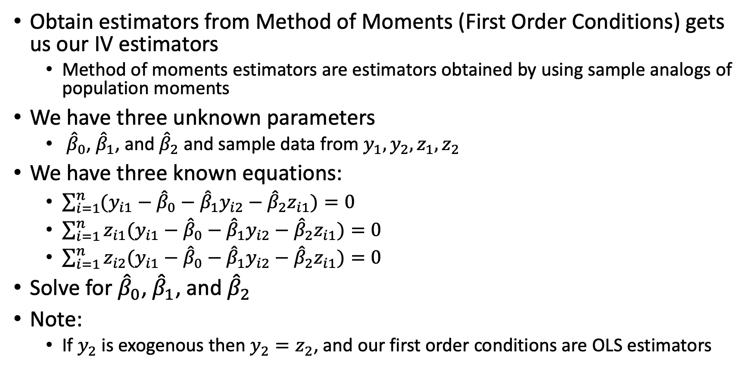
IV Estimation in Multivariate Regression
Obtain estimators from Method of Moments (First Order Conditions) gets us our IV estimators
Method of moments estimators are estimators obtained by using sample analogs of population moments
We have three unknown parameters
${\hat{β}}_{0}$, ${\hat{β}}_{1}$, and ${\hat{β}}_{2}$ and sample data from $y_{1}, y_{2},z_{1},z_{2}$
We have three known equations:
$\sum_{i=1}^{n}{(y_{i1}−{\hat{β}}_{0}−{\hat{β}}_{1}y_{i2}}−{\hat{β}}_{2}z_{i1})=0$
$\sum_{i=1}^{n}{z_{i1}(y_{i1}−{\hat{β}}_{0}−{\hat{β}}_{1}y_{i2}}−{\hat{β}}_{2}z_{i1})=0$
$\sum_{i=1}^{n}{z_{i2}(y_{i1}−{\hat{β}}_{0}−{\hat{β}}_{1}y_{i2}}−{\hat{β}}_{2}z_{i1})=0$
Solve for ${\hat{β}}_{0}$, ${\hat{β}}_{1}$, and ${\hat{β}}_{2}$
Note:
If $y_{2}$ is exogenous then $y_{2}=z_{2}$, and our first order conditions are OLS estimators

Slide 29
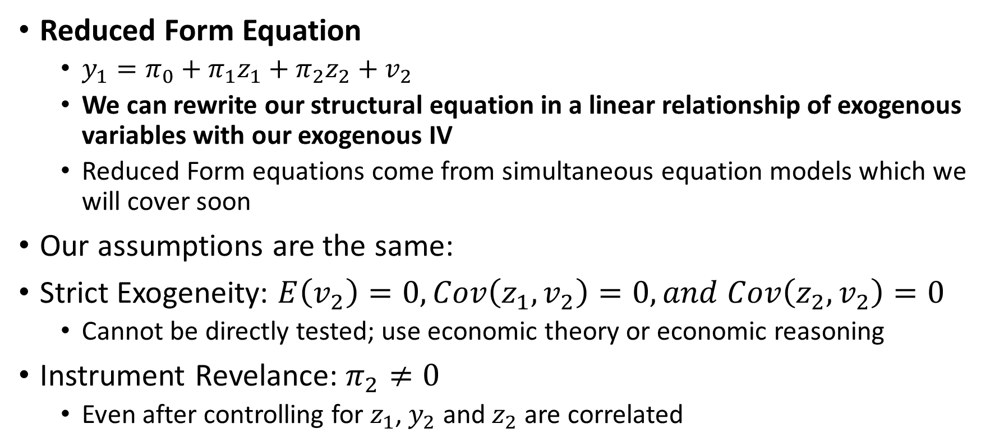
IV Estimation in Multivariate Regression
Reduced Form Equation
$y_{1}=π_{0}+π_{1}z_{1}+π_{2}z_{2}+v_{2}$
We can rewrite our structural equation in a linear relationship of exogenous variables with our exogenous IV
Reduced Form equations come from simultaneous equation models which we will cover soon
Our assumptions are the same:
Strict Exogeneity: $E\left(v_{2}\right)=0, Cov\left(z_{1},v_{2}\right)=0, and Cov\left(z_{2},v_{2}\right)=0$
Cannot be directly tested; use economic theory or economic reasoning
Instrument Revelance: $π_{2}≠0$
Even after controlling for $z_{1}$, $y_{2}$ and $z_{2}$ are correlated

Slide 30
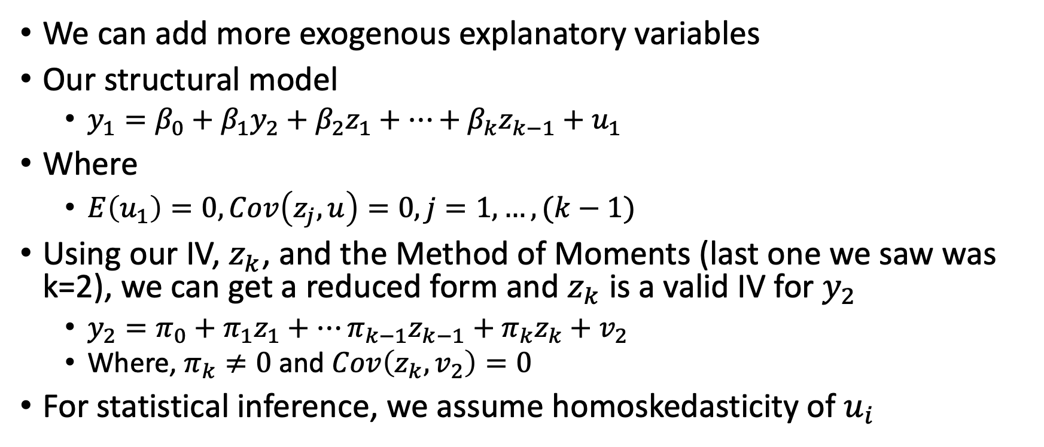
IV Estimation in Multivariate Regression
We can add more exogenous explanatory variables
Our structural model
$y_{1}=β_{0}+β_{1}y_{2}+β_{2}z_{1}+…+β_{k}z_{k−1}+u_{1}$
Where
$E\left(u_{1}\right)=0, Cov\left(z_{j},u\right)=0, j=1,…,(k−1)$
Using our IV, $z_{k}$, and the Method of Moments (last one we saw was k=2), we can get a reduced form and $z_{k}$ is a valid IV for $y_{2}$
$y_{2}=π_{0}+π_{1}z_{1}+…π_{k−1}z_{k−1}+π_{k}z_{k}+v_{2}$
Where, $π_{k}≠0$ and $Cov\left(z_{k},v_{2}\right)=0$
For statistical inference, we assume homoskedasticity of $u_{i}$

Slide 31
Two-Stage Least Squares (2SLS)

Slide 32
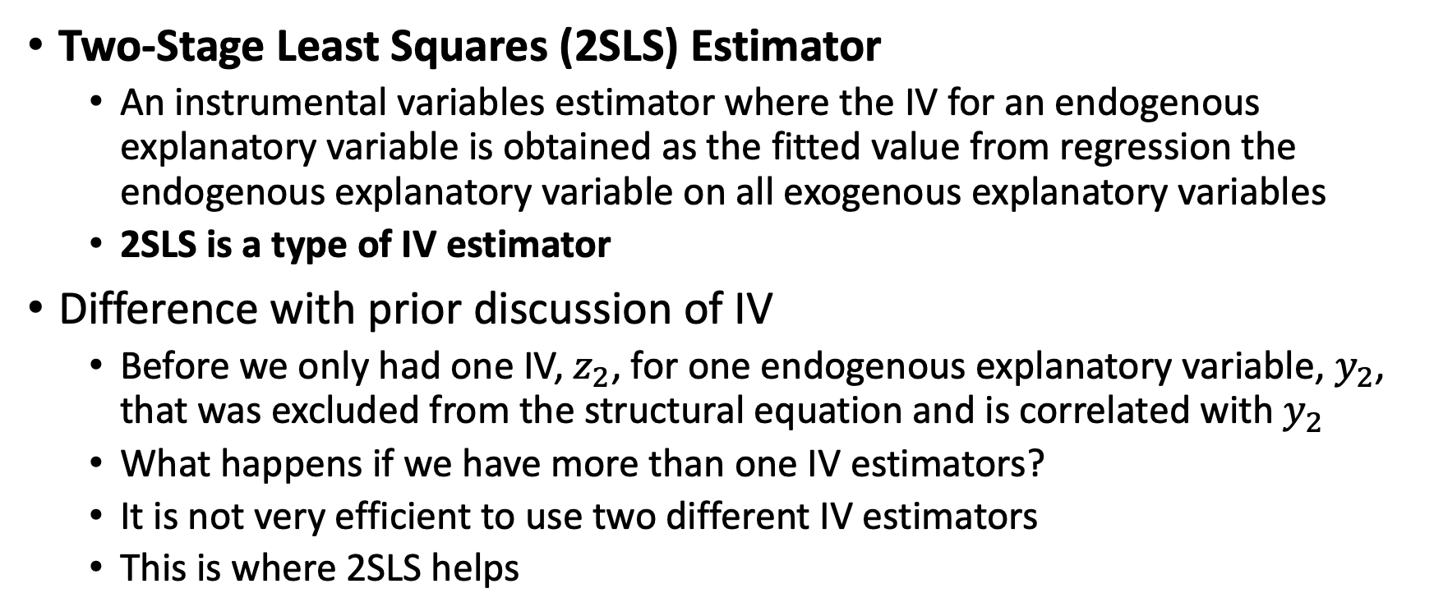
Two-Stage Least Squares
Two-Stage Least Squares (2SLS) Estimator
An instrumental variables estimator where the IV for an endogenous explanatory variable is obtained as the fitted value from regression the endogenous explanatory variable on all exogenous explanatory variables
2SLS is a type of IV estimator
Difference with prior discussion of IV
Before we only had one IV, $z_{2}$, for one endogenous explanatory variable, $y_{2}$, that was excluded from the structural equation and is correlated with $y_{2}$
What happens if we have more than one IV estimators?
It is not very efficient to use two different IV estimators
This is where 2SLS helps

Slide 33
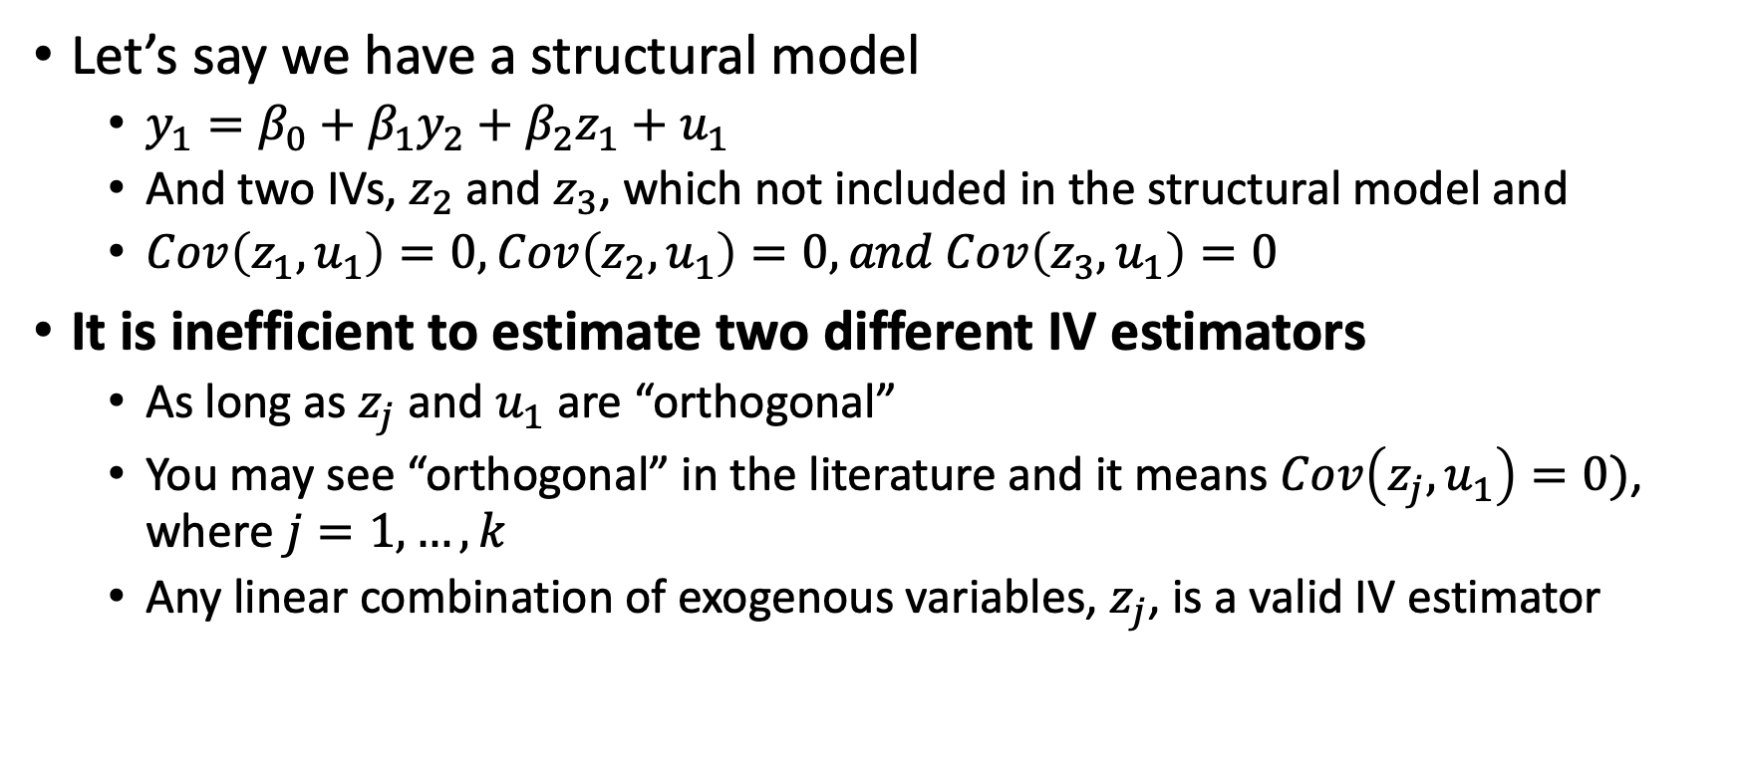
Two-Stage Least Squares
Let’s say we have a structural model
$y_{1}=β_{0}+β_{1}y_{2}+β_{2}z_{1}+u_{1}$
And two IVs, $z_{2}$ and $z_{3}$, which not included in the structural model and
$Cov\left(z_{1},u_{1}\right)=0,Cov\left(z_{2},u_{1}\right)=0, and Cov\left(z_{3},u_{1}\right)=0$
It is inefficient to estimate two different IV estimators
As long as $z_{j}$ and $u_{1}$ are “orthogonal”
You may see “orthogonal” in the literature and it means $Cov\left(z_{j},u_{1}\right)=0)$, where $j=1,…,k$
Any linear combination of exogenous variables, $z_{j}$, is a valid IV estimator

Slide 34
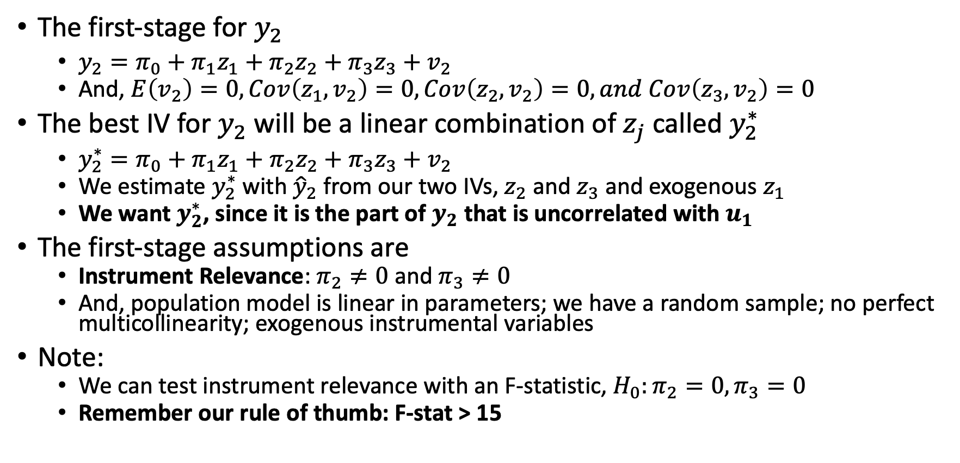
Two-Stage Least Squares
The first-stage for $y_{2}$
$y_{2}=π_{0}+π_{1}z_{1}+π_{2}z_{2}+π_{3}z_{3}+v_{2}$
And, $E\left(v_{2}\right)=0, Cov\left(z_{1},v_{2}\right)=0, Cov\left(z_{2},v_{2}\right)=0, and Cov\left(z_{3},v_{2}\right)=0$
The best IV for $y_{2}$ will be a linear combination of $z_{j}$ called $y_{2}^{∗}$
$y_{2}^{∗}=π_{0}+π_{1}z_{1}+π_{2}z_{2}+π_{3}z_{3}+v_{2}$
We estimate $y_{2}^{∗}$ with ${\hat{y}}_{2}$ from our two IVs, $z_{2}$ and $z_{3}$ and exogenous $z_{1}$
We want $y_{2}^{∗}$, since it is the part of $y_{2}$ that is uncorrelated with $u_{1}$
The first-stage assumptions are
Instrument Relevance: $π_{2}≠0$ and $π_{3}≠0$
And, population model is linear in parameters; we have a random sample; no perfect multicollinearity; exogenous instrumental variables
Note:
We can test instrument relevance with an F-statistic, $H_{0}:π_{2}=0, π_{3}=0$
Remember our rule of thumb: F-stat > 15

Slide 35
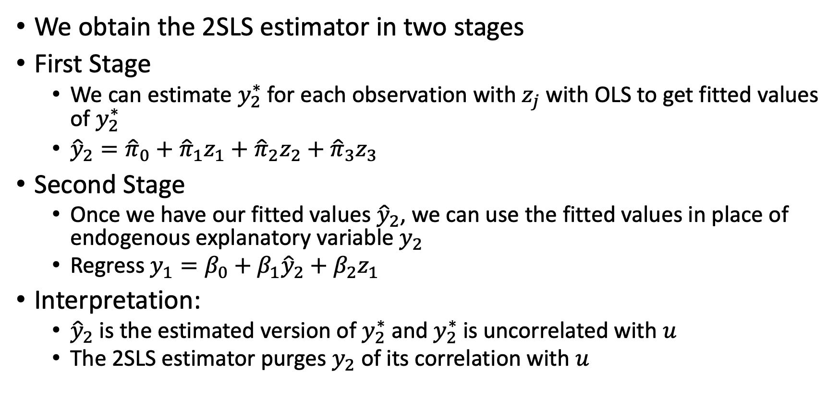
Two-Stage Least Squares
We obtain the 2SLS estimator in two stages
First Stage
We can estimate $y_{2}^{∗}$ for each observation with $z_{j}$ with OLS to get fitted values of $y_{2}^{∗}$
${\hat{y}}_{2}={\hat{π}}_{0}+{\hat{π}}_{1}z_{1}+{\hat{π}}_{2}z_{2}+{\hat{π}}_{3}z_{3}$
Second Stage
Once we have our fitted values ${\hat{y}}_{2}$, we can use the fitted values in place of endogenous explanatory variable $y_{2}$
Regress $y_{1}=β_{0}+β_{1}{\hat{y}}_{2}+β_{2}z_{1}$
Interpretation:
${\hat{y}}_{2}$ is the estimated version of $y_{2}^{∗}$ and $y_{2}^{∗}$ is uncorrelated with $u$
The 2SLS estimator purges $y_{2}$ of its correlation with $u$

Slide 36
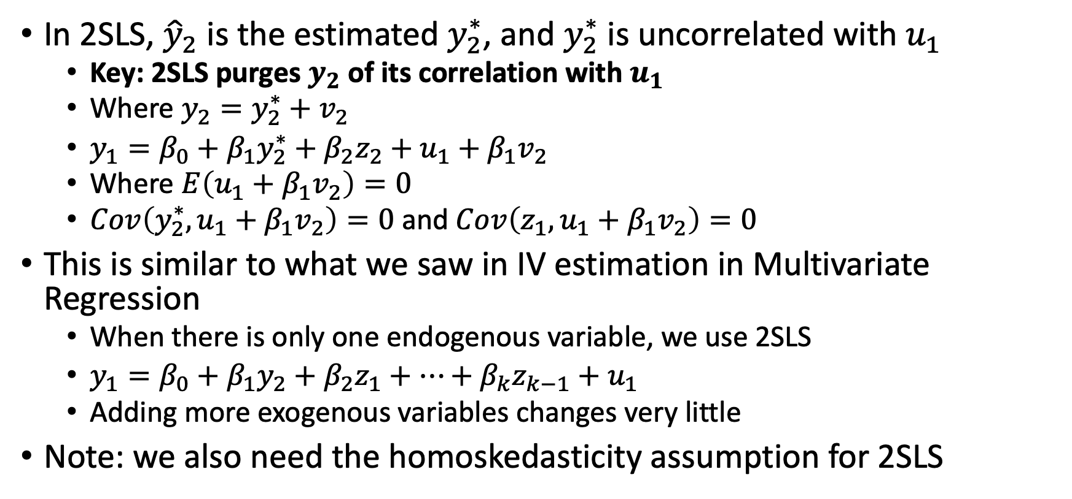
Two-Stage Least Squares
In 2SLS, ${\hat{y}}_{2}$ is the estimated $y_{2}^{∗}$, and $y_{2}^{∗}$ is uncorrelated with $u_{1}$
Key: 2SLS purges $y_{2}$ of its correlation with $u_{1}$
Where $y_{2}=y_{2}^{∗}+v_{2}$
$y_{1}=β_{0}+β_{1}y_{2}^{∗}+β_{2}z_{2}+u_{1}+β_{1}v_{2}$
Where $E\left(u_{1}+β_{1}v_{2}\right)=0$
$Cov\left(y_{2}^{∗},u_{1}+β_{1}v_{2}\right)=0$ and $Cov\left(z_{1},u_{1}+β_{1}v_{2}\right)=0$
This is similar to what we saw in IV estimation in Multivariate Regression
When there is only one endogenous variable, we use 2SLS
$y_{1}=β_{0}+β_{1}y_{2}+β_{2}z_{1}+…+β_{k}z_{k−1}+u_{1}$
Adding more exogenous variables changes very little
Note: we also need the homoskedasticity assumption for 2SLS

Slide 37
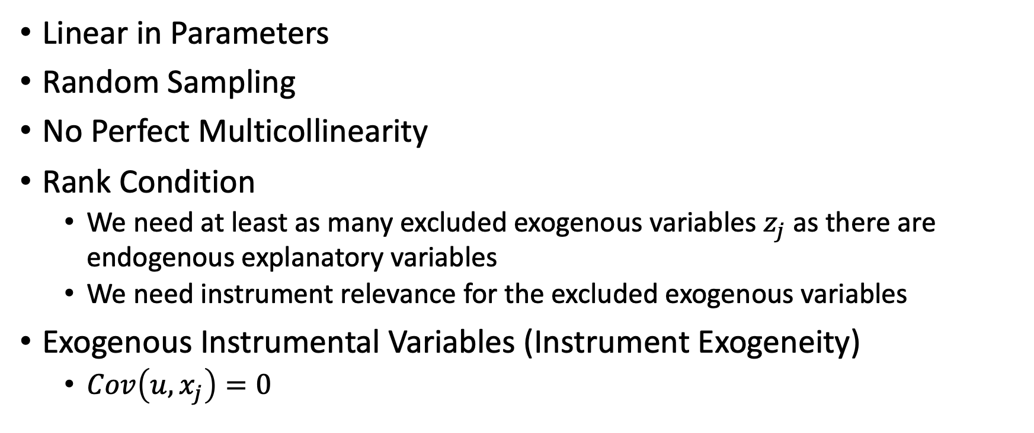
Assumptions of the 2SLS
Linear in Parameters
Random Sampling
No Perfect Multicollinearity
Rank Condition
We need at least as many excluded exogenous variables $z_{j}$ as there are endogenous explanatory variables
We need instrument relevance for the excluded exogenous variables
Exogenous Instrumental Variables (Instrument Exogeneity)
$Cov\left(u,x_{j}\right)=0$

Slide 38
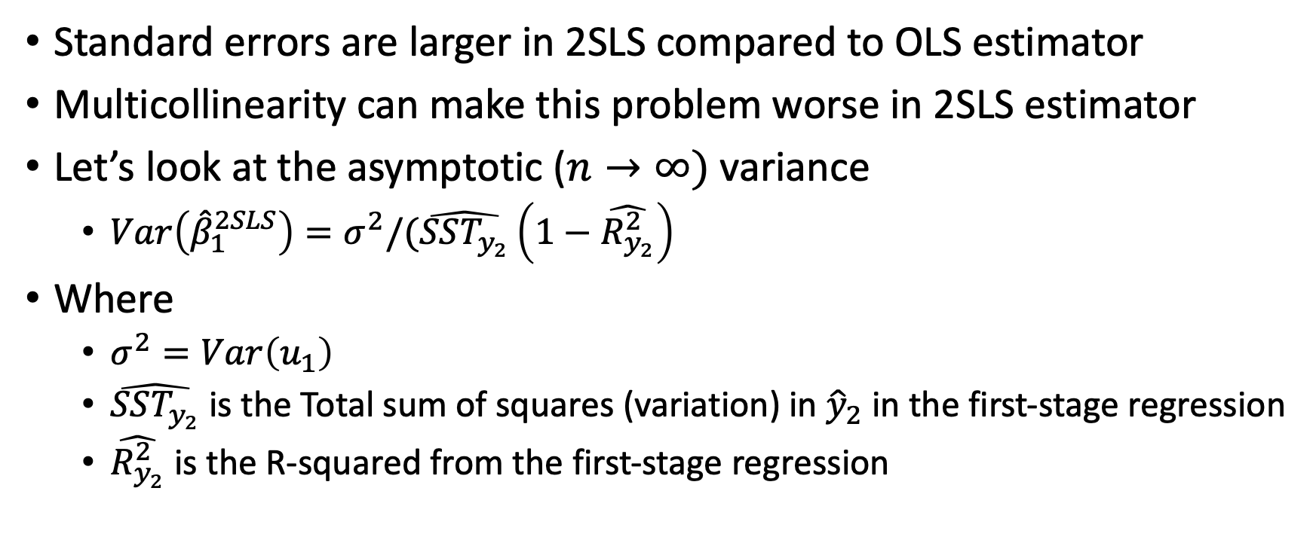
Multicollinearity and 2SLS
Standard errors are larger in 2SLS compared to OLS estimator
Multicollinearity can make this problem worse in 2SLS estimator
Let’s look at the asymptotic ($n→∞)$ variance
$Var\left({\hat{β}}_{1}^{2SLS}\right)=σ^{2}/(\hat{SST_{y_{2}}}\left(1−\hat{R_{y_{2}}^{2}}\right)$
Where
$σ^{2}=Var\left(u_{1}\right)$
$\hat{SST_{y_{2}}}$ is the Total sum of squares (variation) in ${\hat{y}}_{2}$ in the first-stage regression
$\hat{R_{y_{2}}^{2}}$ is the R-squared from the first-stage regression

Slide 39
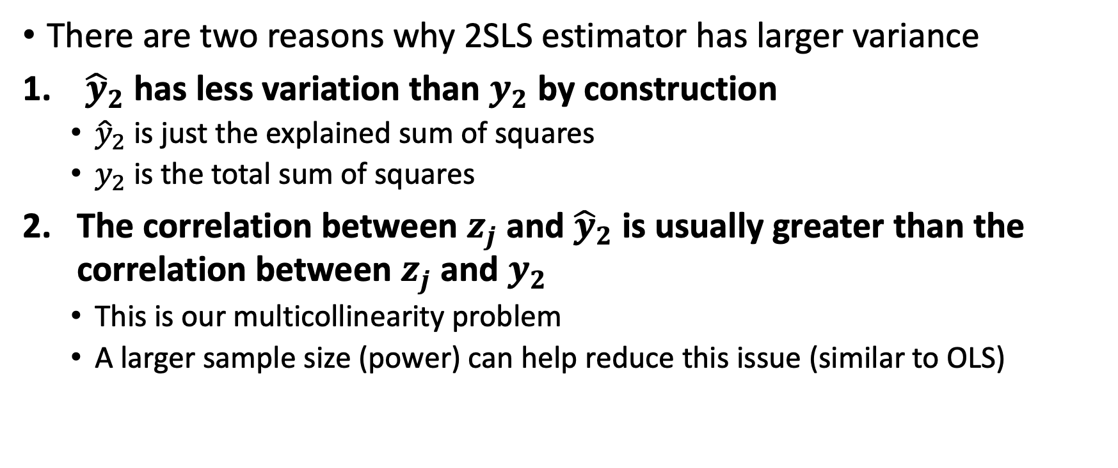
Multicollinearity and 2SLS
There are two reasons why 2SLS estimator has larger variance
${\hat{y}}_{2}$ has less variation than $y_{2}$ by construction
${\hat{y}}_{2}$ is just the explained sum of squares
$y_{2}$ is the total sum of squares
The correlation between $z_{j}$ and ${\hat{y}}_{2}$ is usually greater than the correlation between $z_{j}$ and $y_{2}$
This is our multicollinearity problem
A larger sample size (power) can help reduce this issue (similar to OLS)

Slide 40
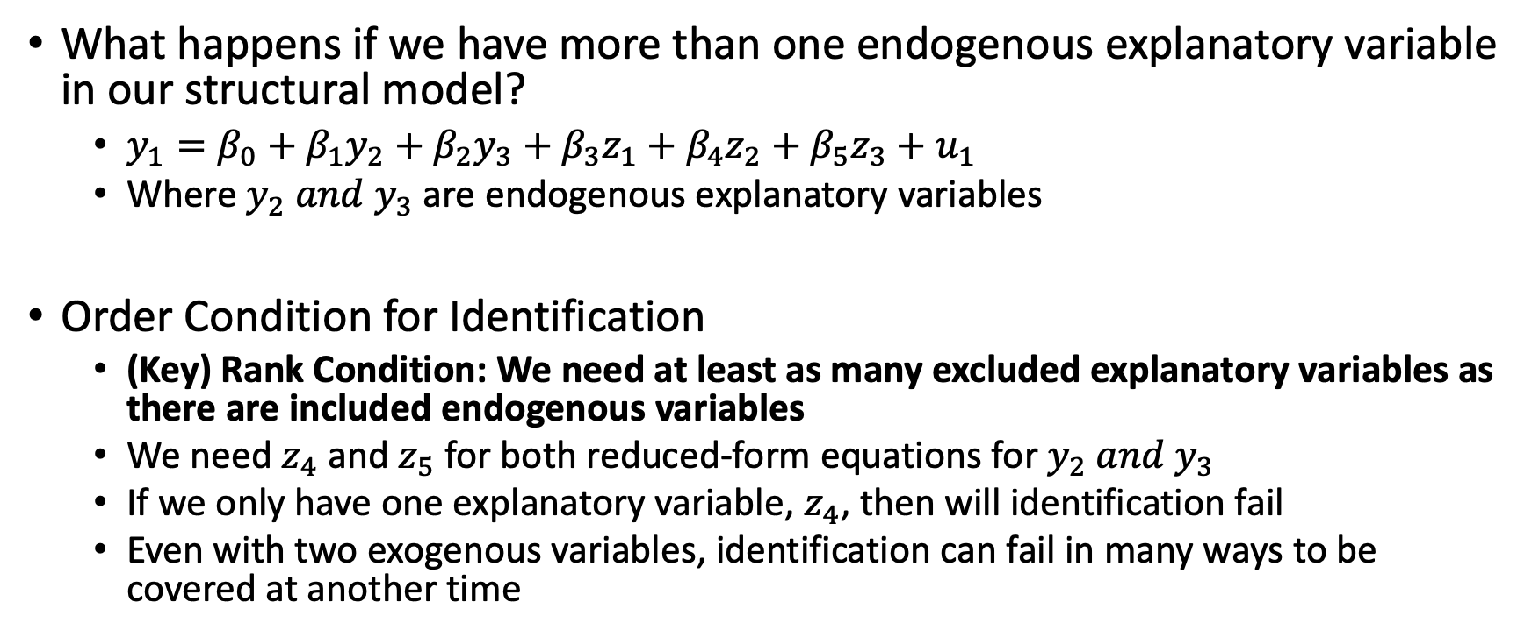
Multiple Endogenous Variables
What happens if we have more than one endogenous explanatory variable in our structural model?
$y_{1}=β_{0}+β_{1}y_{2}+β_{2}y_{3}+β_{3}z_{1}+β_{4}z_{2}+β_{5}z_{3}+u_{1}$
Where $y_{2} and y_{3}$ are endogenous explanatory variables
Order Condition for Identification
(Key) Rank Condition: We need at least as many excluded explanatory variables as there are included endogenous variables
We need $z_{4}$ and $z_{5}$ for both reduced-form equations for $y_{2} and y_{3}$
If we only have one explanatory variable, $z_{4}$, then will identification fail
Even with two exogenous variables, identification can fail in many ways to be covered at another time

Slide 41
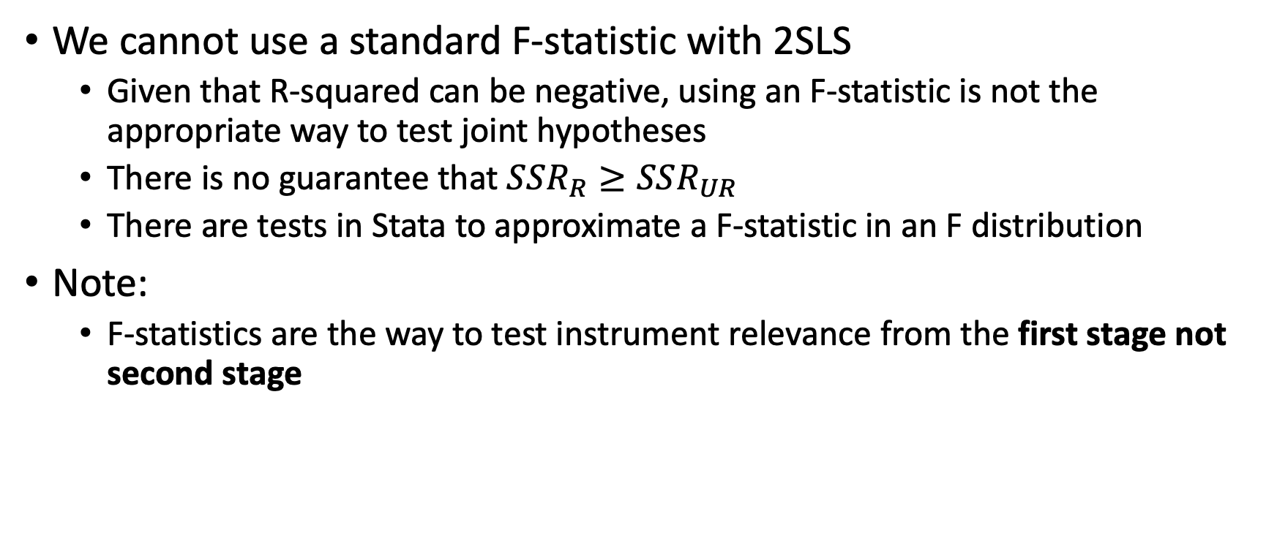
Testing Multiple Hypotheses with 2SLS
We cannot use a standard F-statistic with 2SLS
Given that R-squared can be negative, using an F-statistic is not the appropriate way to test joint hypotheses
There is no guarantee that $SSR_{R}≥SSR_{UR}$
There are tests in Stata to approximate a F-statistic in an F distribution
Note:
F-statistics are the way to test instrument relevance from the first stage not second stage

Slide 42
IV for Classic Error-in-Variables

Slide 43
IV for Classic Error-in-Variables Problem
IV can also solve endogeneity problems from Classic Error-in-Variable bias from measurement error
Endogeneity from Classic Error in Variables (CEV) can bias our estimates of the population parameters using the OLS estimator
Measurement Error
Sometimes we cannot collect or imperfect collect data on the variable of interest that affects economic behavior
And, our recorded measures of a quantifiable measure may contain errors

Slide 44
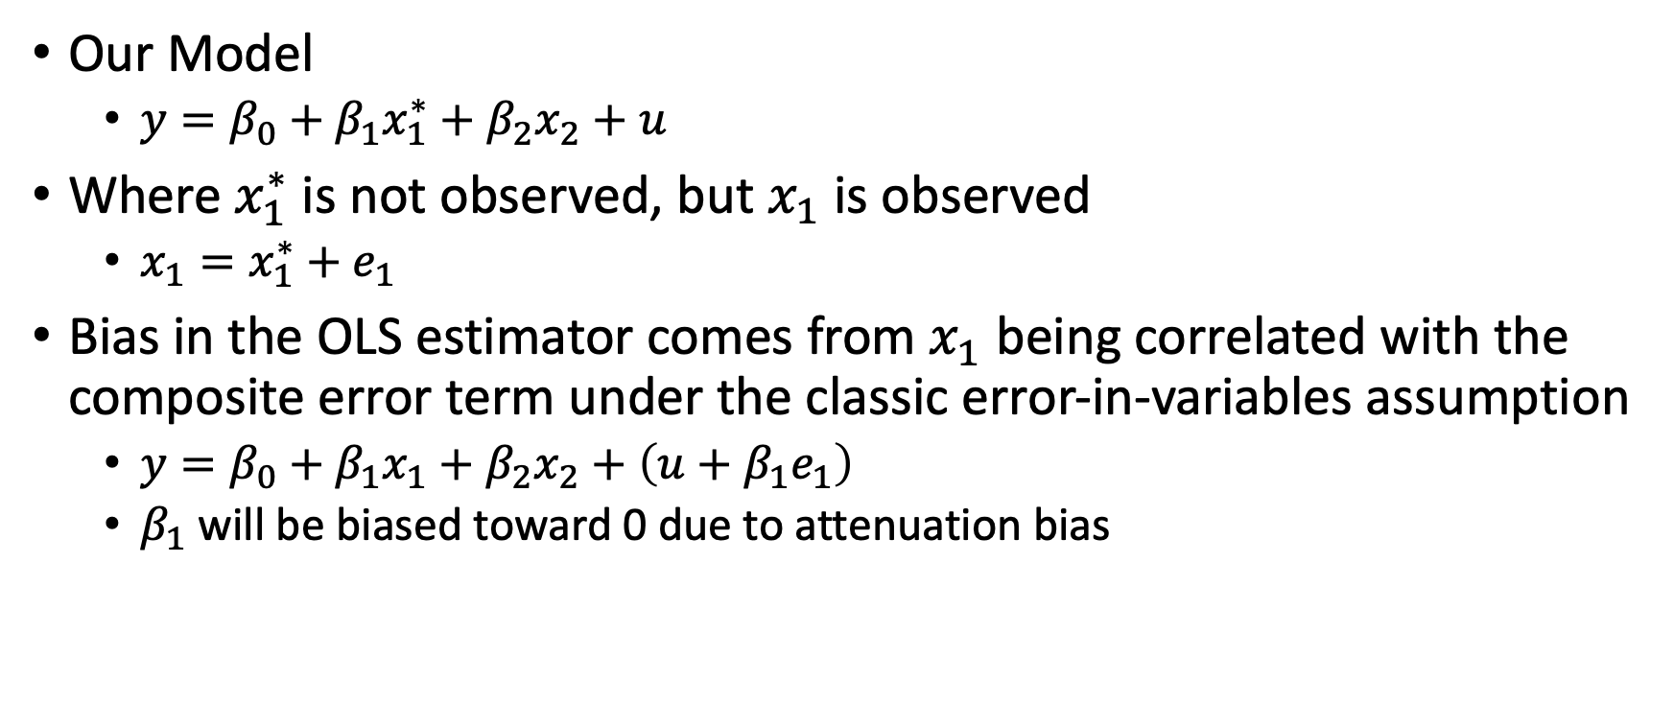
IV for Classic Error-in-Variables Problem
Our Model
$y=β_{0}+β_{1}x_{1}^{∗}+β_{2}x_{2}+u$
Where $x_{1}^{∗}$ is not observed, but $x_{1}$ is observed
$x_{1}=x_{1}^{∗}+e_{1}$
Bias in the OLS estimator comes from $x_{1}$ being correlated with the composite error term under the classic error-in-variables assumption
$y=β_{0}+β_{1}x_{1}+β_{2}x_{2}+\left(u+β_{1}e_{1}\right)$
$β_{1}$ will be biased toward 0 due to attenuation bias

Slide 45
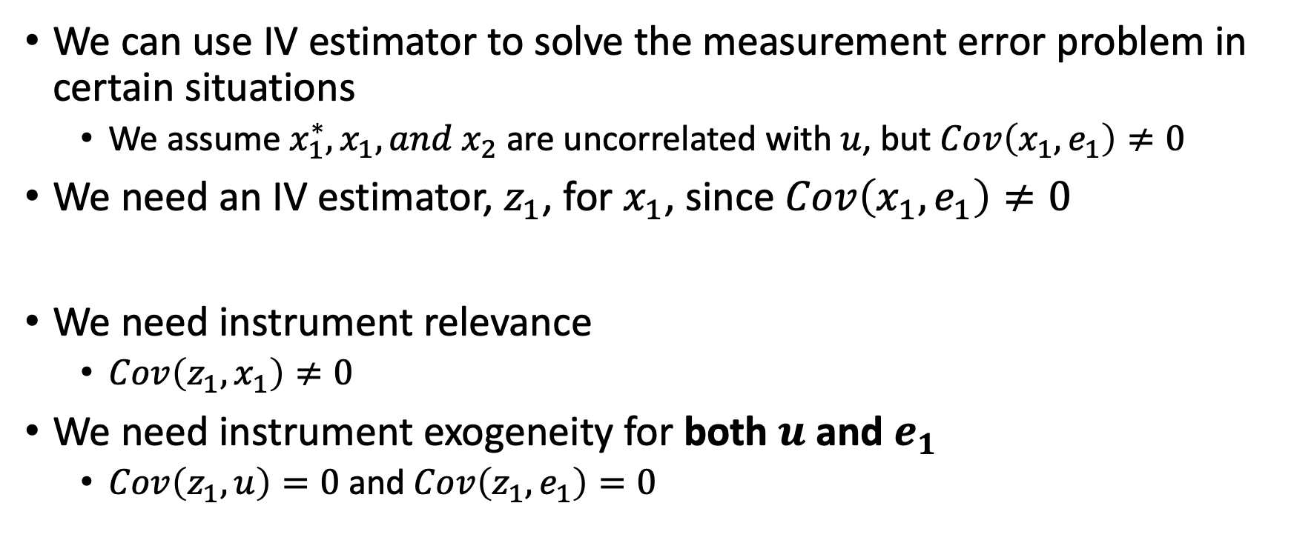
IV for Classic Error-in-Variables Problem
We can use IV estimator to solve the measurement error problem in certain situations
We assume $x_{1}^{∗}, x_{1},and x_{2}$ are uncorrelated with $u$, but $Cov\left(x_{1},e_{1}\right)≠0$
We need an IV estimator, $z_{1}$, for $x_{1}$, since $Cov\left(x_{1},e_{1}\right)≠0$
We need instrument relevance
$Cov\left(z_{1},x_{1}\right)≠0$
We need instrument exogeneity for both $u$ and $e_{1}$
$Cov\left(z_{1},u\right)=0$ and $Cov\left(z_{1},e_{1}\right)=0$

Slide 46
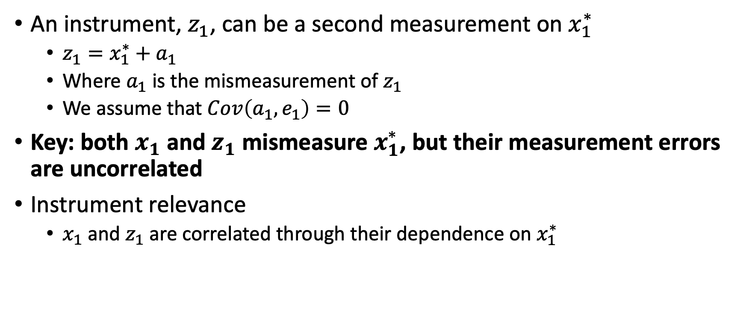
IV for Classic Error-in-Variables Problem
An instrument, $z_{1}$, can be a second measurement on $x_{1}^{∗}$
$z_{1}=x_{1}^{∗}+a_{1}$
Where $a_{1}$ is the mismeasurement of $z_{1}$
We assume that $Cov\left(a_{1},e_{1}\right)=0$
Key: both $x_{1}$ and $z_{1}$ mismeasure $x_{1}^{∗}$, but their measurement errors are uncorrelated
Instrument relevance
$x_{1}$ and $z_{1}$ are correlated through their dependence on $x_{1}^{∗}$

Slide 47
IV for Classic Error-in-Variables Problem
Two measures for an explanatory variable can be rare
Ashenfelter and Krueger (1994) looked at twins to assess returns to education, and each twin was asked about level of education
Self-reported education and reported education from twin
An alternative is to use other exogenous variables as IVs for mismeasured variables
We could use father’s education and mother’s education as IVs for education if education is mismeasured

Slide 48
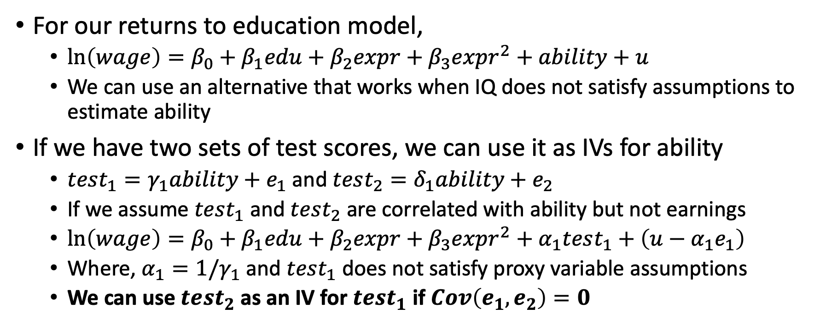
IV for Omitted Variables
For our returns to education model,
$\ln\left(wage\right)=β_{0}+β_{1}edu+β_{2}expr+β_{3}expr^{2}+ability+u$
We can use an alternative that works when IQ does not satisfy assumptions to estimate ability
If we have two sets of test scores, we can use it as IVs for ability
$test_{1}=γ_{1}ability+e_{1}$ and$test_{2}=δ_{1}ability+e_{2}$
If we assume $test_{1}$ and $test_{2}$ are correlated with ability but not earnings
$\ln\left(wage\right)=β_{0}+β_{1}edu+β_{2}expr+β_{3}expr^{2}+α_{1}test_{1}+\left(u−α_{1}e_{1}\right)$
Where, $α_{1}=1/γ_{1}$ and $test_{1}$ does not satisfy proxy variable assumptions
We can use $test_{2}$ as an IV for $test_{1}$ if $Cov\left(e_{1},e_{2}\right)=0$

Slide 49
2SLS with Heteroskedasticity

Slide 50
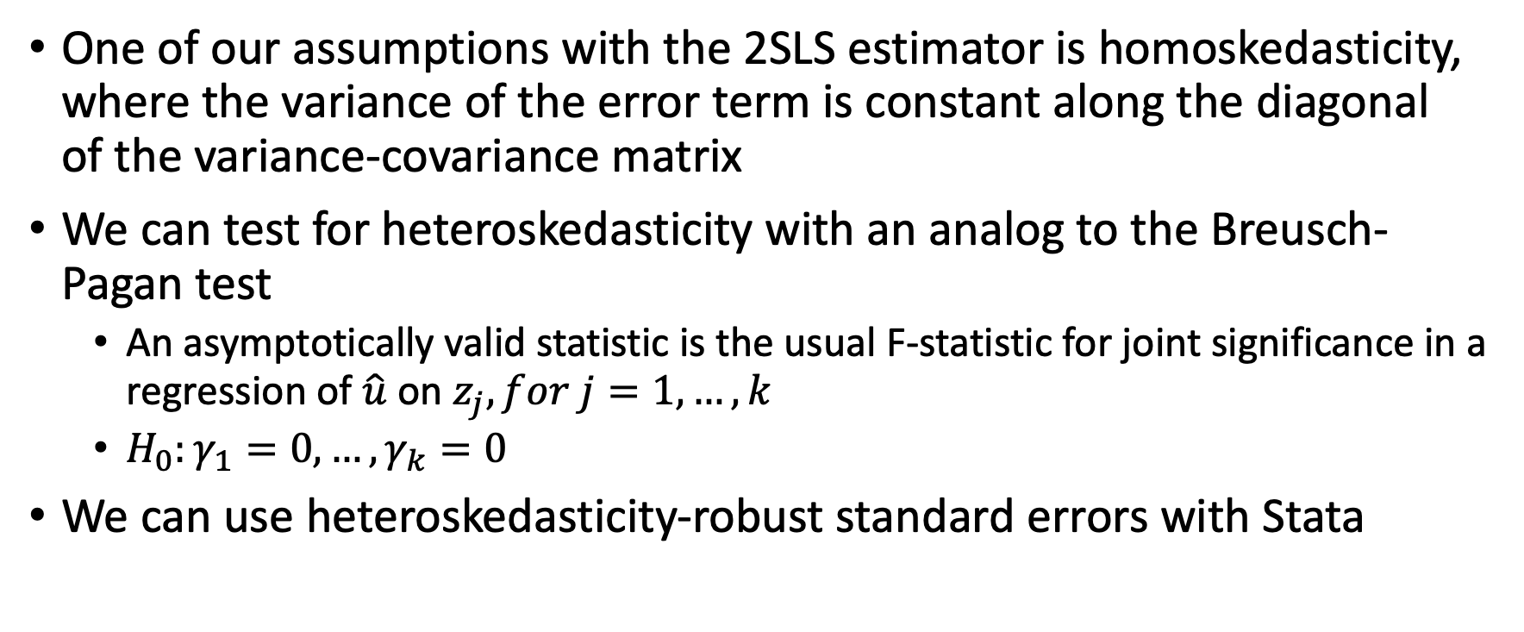
2SLS with Heteroskedasticity
One of our assumptions with the 2SLS estimator is homoskedasticity, where the variance of the error term is constant along the diagonal of the variance-covariance matrix
We can test for heteroskedasticity with an analog to the Breusch-Pagan test
An asymptotically valid statistic is the usual F-statistic for joint significance in a regression of $\hat{u}$ on $z_{j}, for j=1,…,k$
$H_{0}:γ_{1}=0,…,γ_{k}=0$
We can use heteroskedasticity-robust standard errors with Stata

Slide 51
Testing for Endogeneity and Overidentifying Restrictions

Slide 52
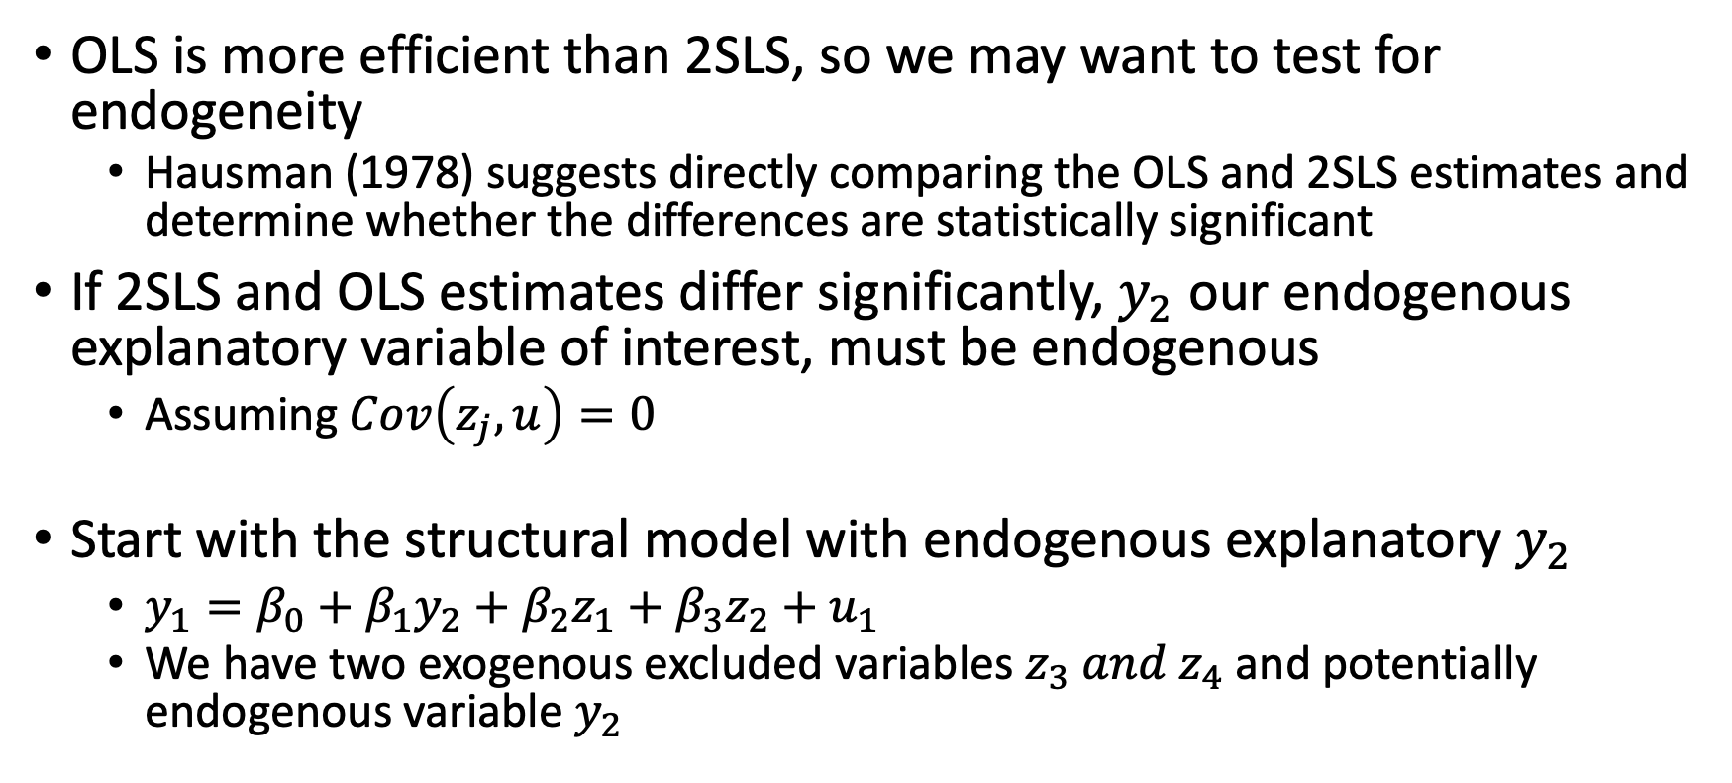
Testing for Endogeneity
OLS is more efficient than 2SLS, so we may want to test for endogeneity
Hausman (1978) suggests directly comparing the OLS and 2SLS estimates and determine whether the differences are statistically significant
If 2SLS and OLS estimates differ significantly, $y_{2}$ our endogenous explanatory variable of interest, must be endogenous
Assuming $Cov\left(z_{j},u\right)=0$
Start with the structural model with endogenous explanatory $y_{2}$
$y_{1}=β_{0}+β_{1}y_{2}+β_{2}z_{1}+β_{3}z_{2}+u_{1}$
We have two exogenous excluded variables $z_{3} and z_{4}$ and potentially endogenous variable $y_{2}$

Slide 53
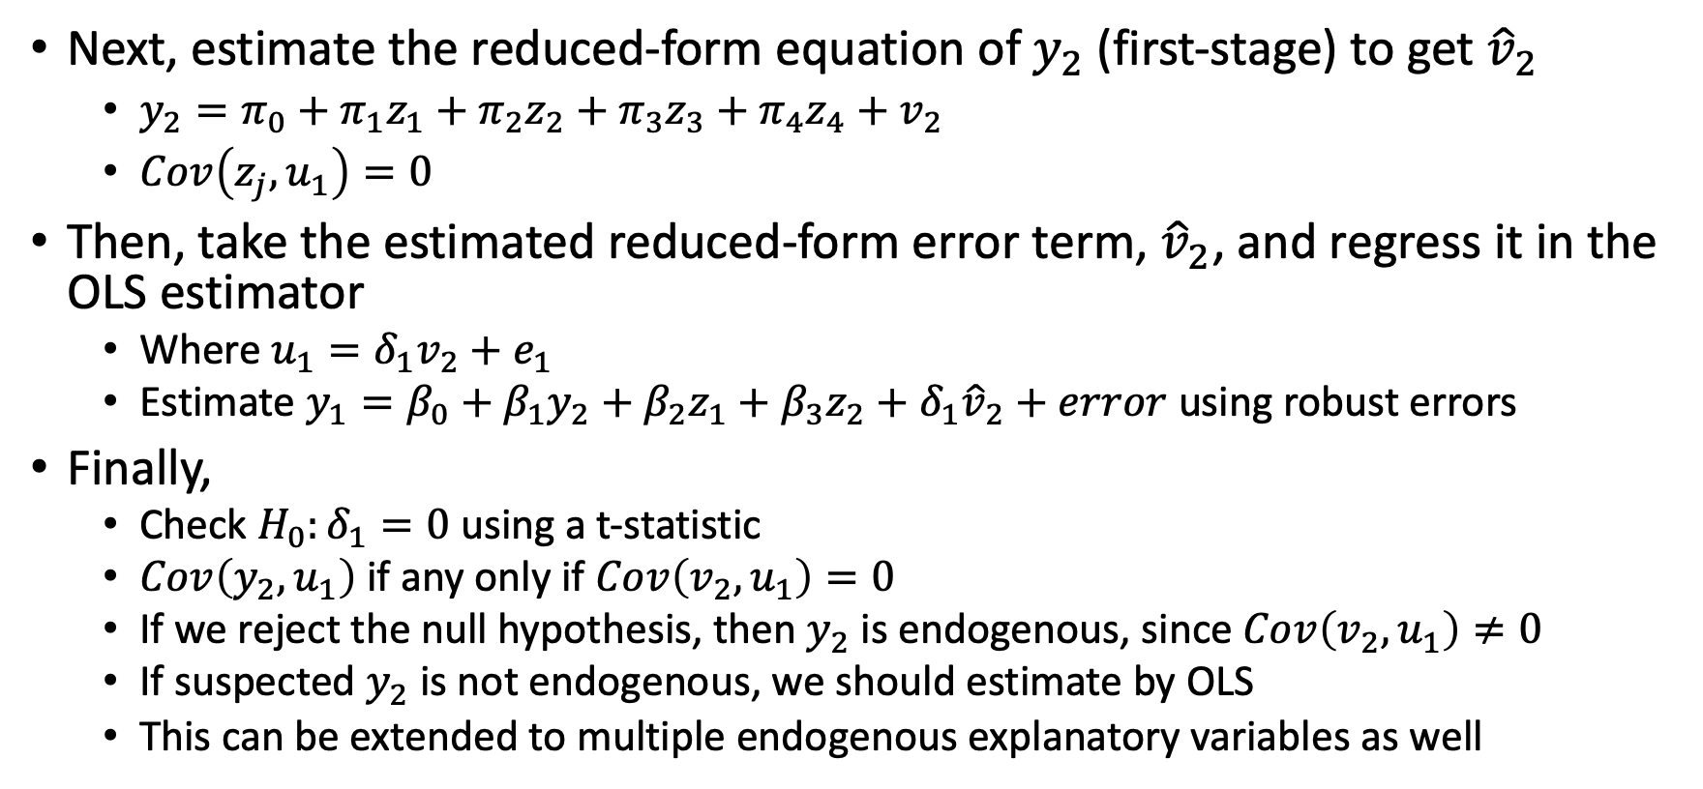
Testing for Endogeneity
Next, estimate the reduced-form equation of $y_{2}$ (first-stage) to get ${\hat{v}}_{2}$
$y_{2}=π_{0}+π_{1}z_{1}+π_{2}z_{2}+π_{3}z_{3}+π_{4}z_{4}+v_{2}$
$Cov\left(z_{j},u_{1}\right)=0$
Then, take the estimated reduced-form error term, ${\hat{v}}_{2}$, and regress it in the OLS estimator
Where $u_{1}=δ_{1}v_{2}+e_{1}$
Estimate $y_{1}=β_{0}+β_{1}y_{2}+β_{2}z_{1}+β_{3}z_{2}+δ_{1}{\hat{v}}_{2}+error$ using robust errors
Finally,
Check $H_{0}:δ_{1}=0$ using a t-statistic
$Cov\left(y_{2},u_{1}\right)$ if any only if $Cov\left(v_{2},u_{1}\right)=0$
If we reject the null hypothesis, then $y_{2}$ is endogenous, since $Cov\left(v_{2},u_{1}\right)≠0$
If suspected $y_{2}$ is not endogenous, we should estimate by OLS
This can be extended to multiple endogenous explanatory variables as well

Slide 54
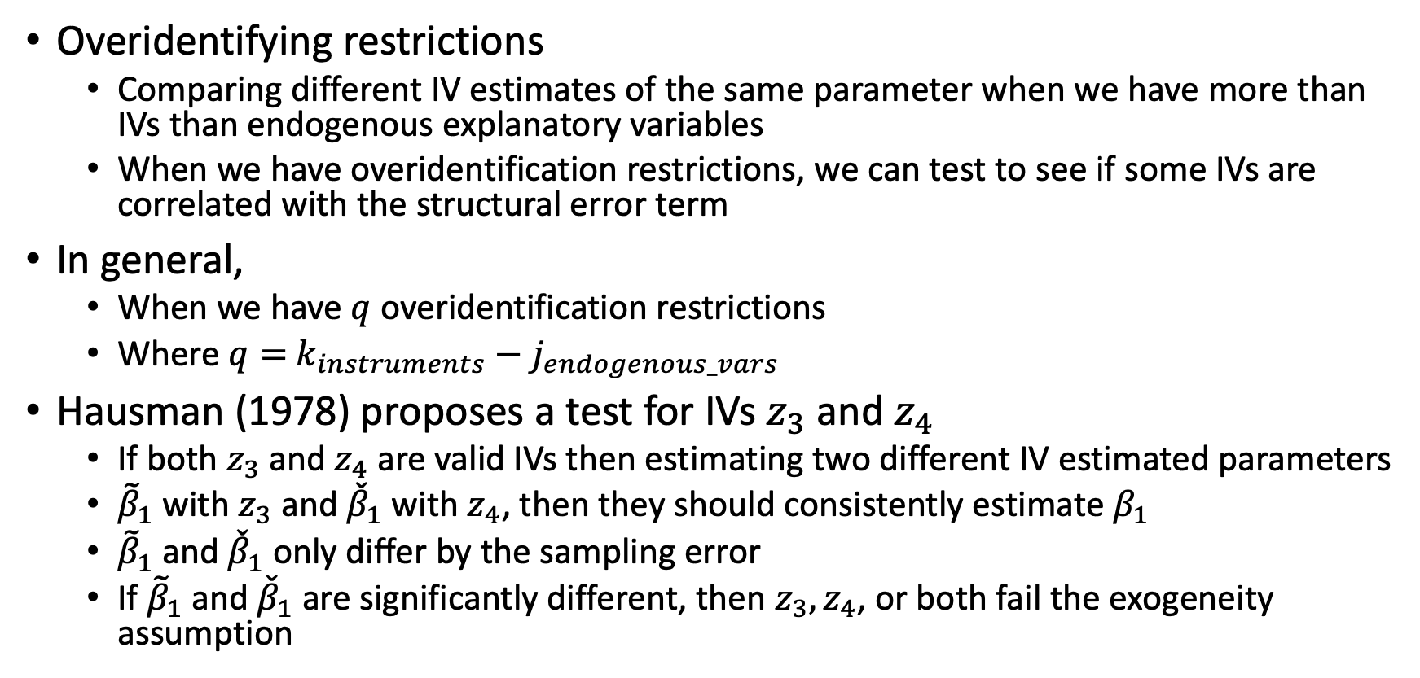
Testing for Overidentification Restrictions
Overidentifying restrictions
Comparing different IV estimates of the same parameter when we have more than IVs than endogenous explanatory variables
When we have overidentification restrictions, we can test to see if some IVs are correlated with the structural error term
In general,
When we have $q$ overidentification restrictions
Where $q=$ $k_{instruments}−j_{endogenous_vars}$
Hausman (1978) proposes a test for IVs $z_{3}$ and $z_{4}$
If both $z_{3}$ and $z_{4}$ are valid IVs then estimating two different IV estimated parameters
${\tilde{β}}_{1}$ with $z_{3}$ and ${\check{β}}_{1}$ with $z_{4}$, then they should consistently estimate $β_{1}$
${\tilde{β}}_{1}$ and ${\check{β}}_{1}$only differ by the sampling error
If ${\tilde{β}}_{1}$ and ${\check{β}}_{1}$are significantly different, then $z_{3}, z_{4}$, or both fail the exogeneity assumption

Slide 55
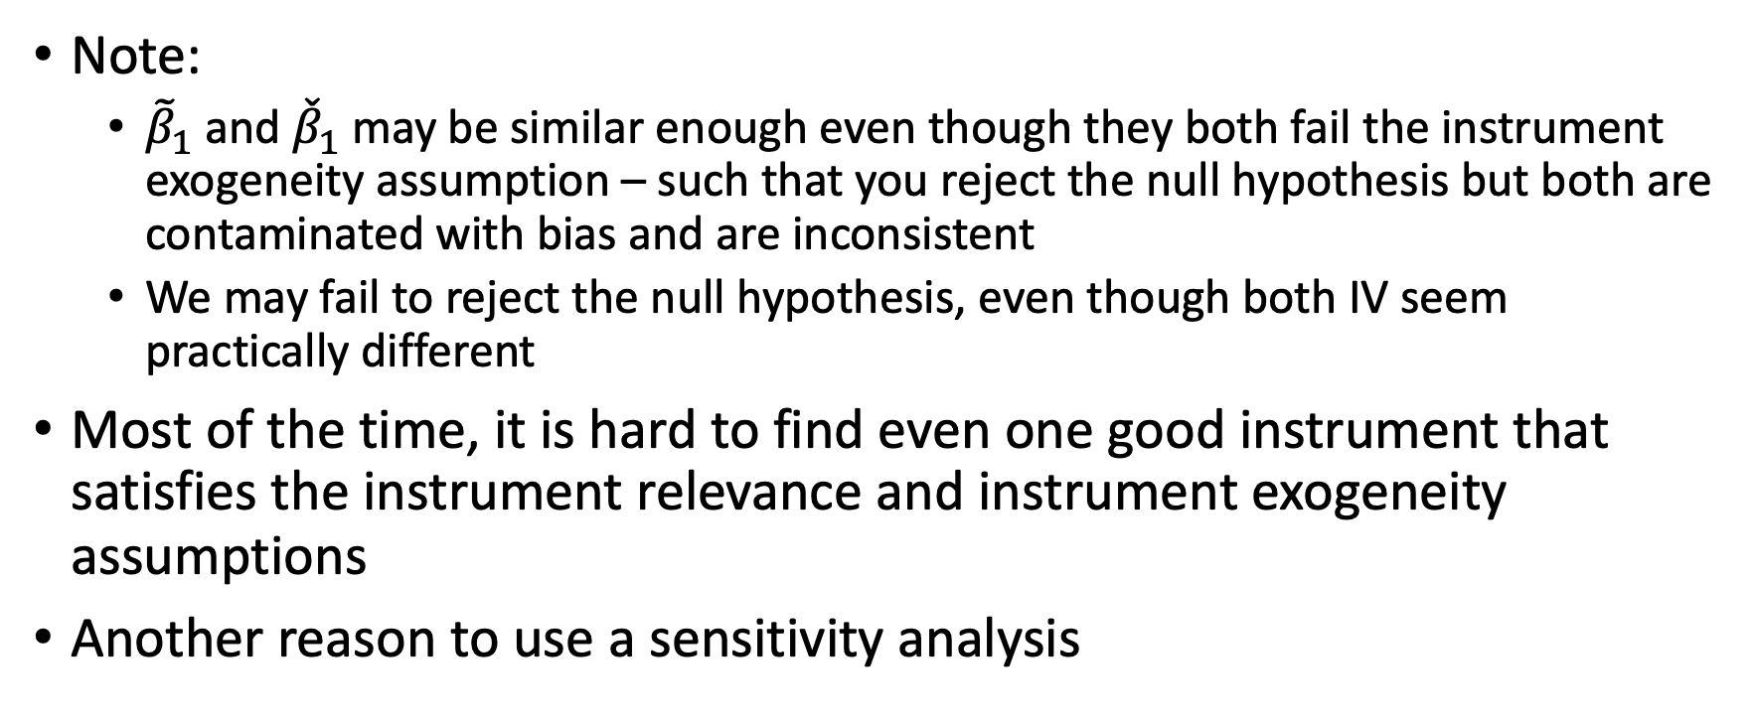
Testing Overidentification Restrictions
Note:
${\tilde{β}}_{1}$ and ${\check{β}}_{1}$may be similar enough even though they both fail the instrument exogeneity assumption – such that you reject the null hypothesis but both are contaminated with bias and are inconsistent
We may fail to reject the null hypothesis, even though both IV seem practically different
Most of the time, it is hard to find even one good instrument that satisfies the instrument relevance and instrument exogeneity assumptions
Another reason to use a sensitivity analysis

Slide 56
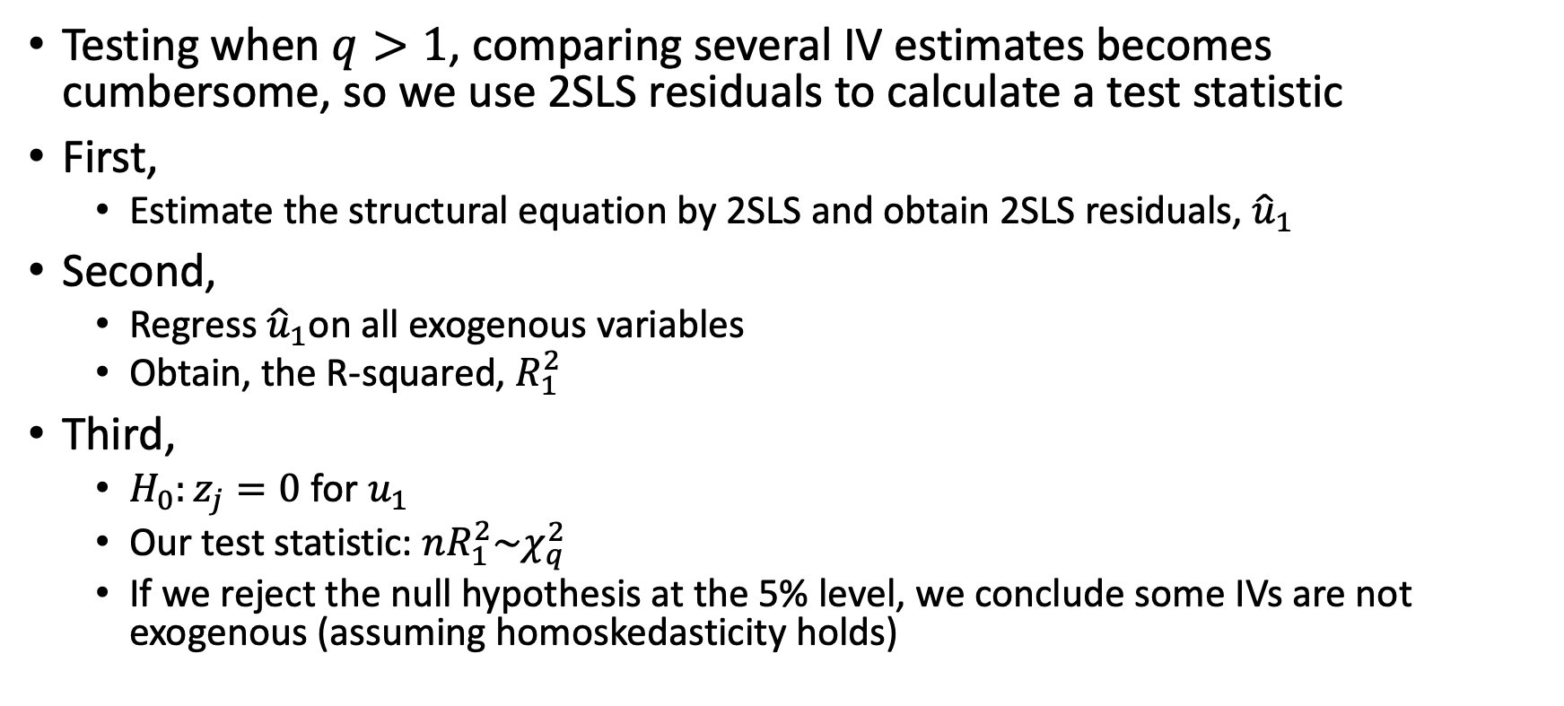
Testing Overidentification Restrictions
Testing when $q>1$, comparing several IV estimates becomes cumbersome, so we use 2SLS residuals to calculate a test statistic
First,
Estimate the structural equation by 2SLS and obtain 2SLS residuals, ${\hat{u}}_{1}$
Second,
Regress ${\hat{u}}_{1}$on all exogenous variables
Obtain, the R-squared, $R_{1}^{2}$
Third,
$H_{0}:z_{j}=0$ for $u_{1}$
Our test statistic: $nR_{1}^{2}\sim χ_{q}^{2}$
If we reject the null hypothesis at the 5% level, we conclude some IVs are not exogenous (assuming homoskedasticity holds)

Slide 57
Testing Overidentification Restrictions
When we have the same number of IVs and endogenous parameters our model is just identified
When our model is just identified, we cannot test

Slide 58
Examples of Good Instruments
Lotteries
E.g.: Vietnam lottery draft, charter school lottery
Judge Fixed Effects
Randomized into judges
Bartik Instruments
Shift-Share instruments
These are not always good instruments, but good instruments are really hard to find

Slide 59
To Be Continued…
This is an introduction to instrumental variables
In ECON 672,
What are all of the assumptions of IV
There are 3 addition assumptions we did not discuss
We go into homogenous vs heterogenous potential outcomes
If all assumptions are satisfied, what is the difference between average treatment effects and local average treatment effects of IV?
Can the estimated parameters of IV be applied to everyone or just a subset?\

Slide 60
Stata Lab

